Slide 1
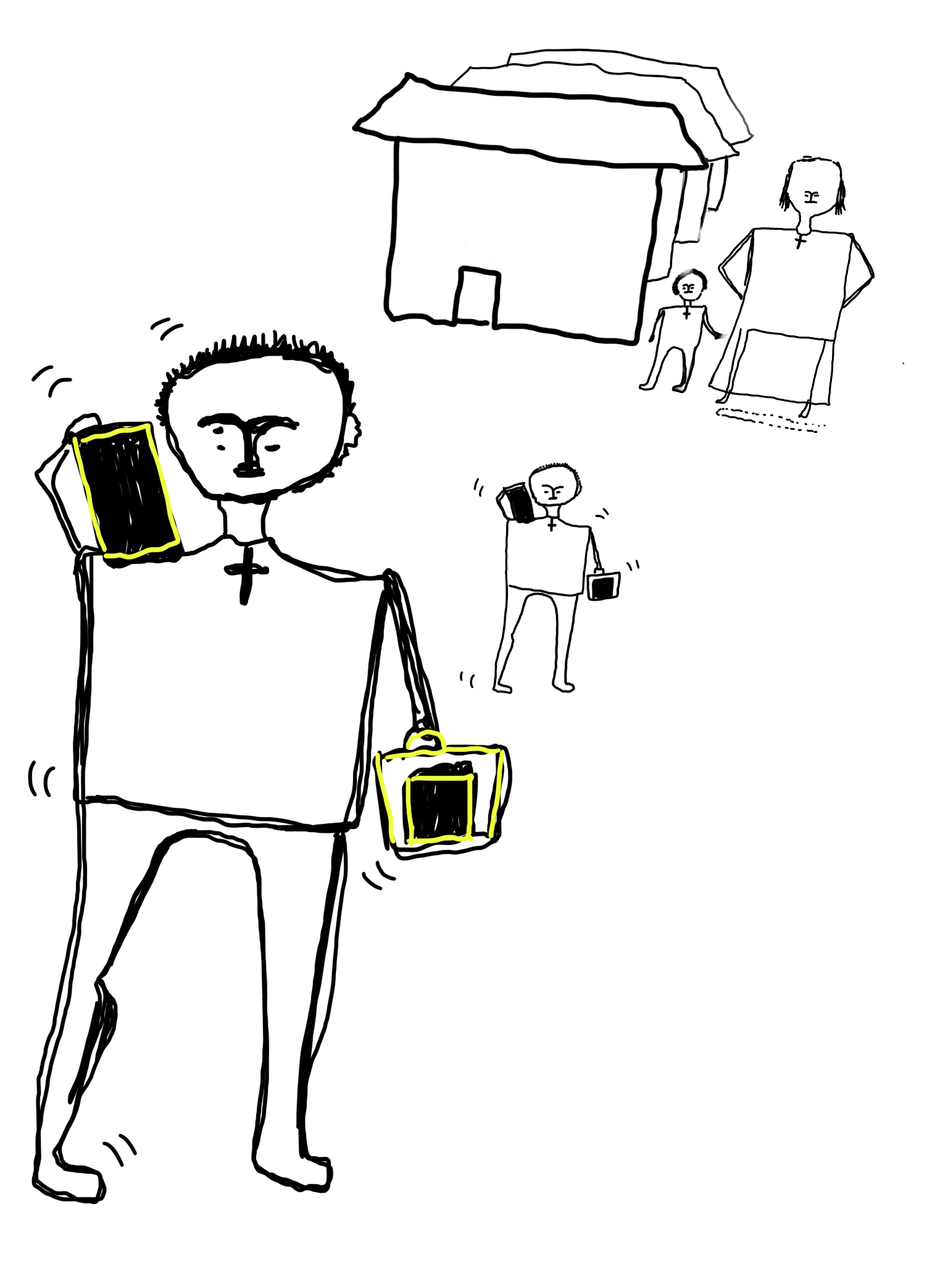
Ayenew
(Ethiopia)
Ayenew is a 14-year-old boy who lives in the Bakelo IDP camp. He lives with his mother. Ayenew’s father died when he was very young. Ayenew's mother doesn't have income to buy food and other necessities.
Ayenew and his mother have not been receiving sufficient food aid and other necessities. Ayenew works as a porter to support his mother and himself. Ayenew doesn´t go to school.

Slide 2
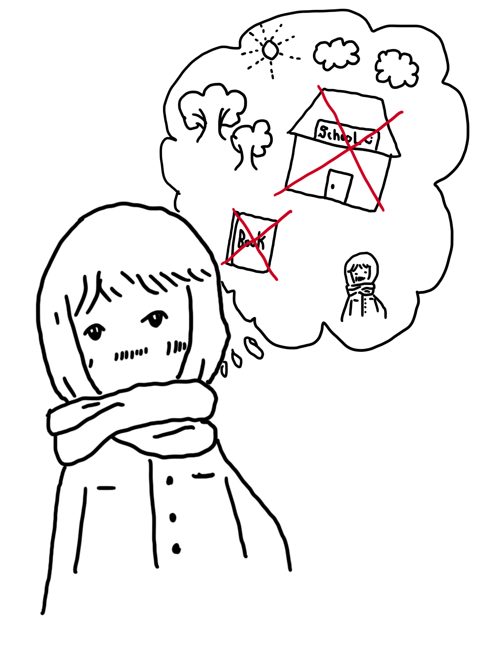
Votey
(Cambodia)
Votey is 15 years old, she has three brothers and one sister. She was born in a poor family in a rural area in Cambodia. She is the first child in the family. Her family is poor and has no regular income to buy food or pay for medicine. As a result, her mom takes out a loan from a micro credit institution in the village to support the family's basic needs. After taking this loan, her mom is able to pay the loan back on time, so her mom decides to go to a money lender in the village to take some loans even if it is high interest.
As the results, the family situation becomes harder and harder. To support family and to find money to pay the interest, her mother ask Vatey to quit school to work in the factory in her nearby village to earn more income to support the family and repaying loan, one more her mother thinks the the daughter is kitchen bound so it is useless for her to continue her study. Vatey does not want to drop out of school but she has no choices.

Slide 3
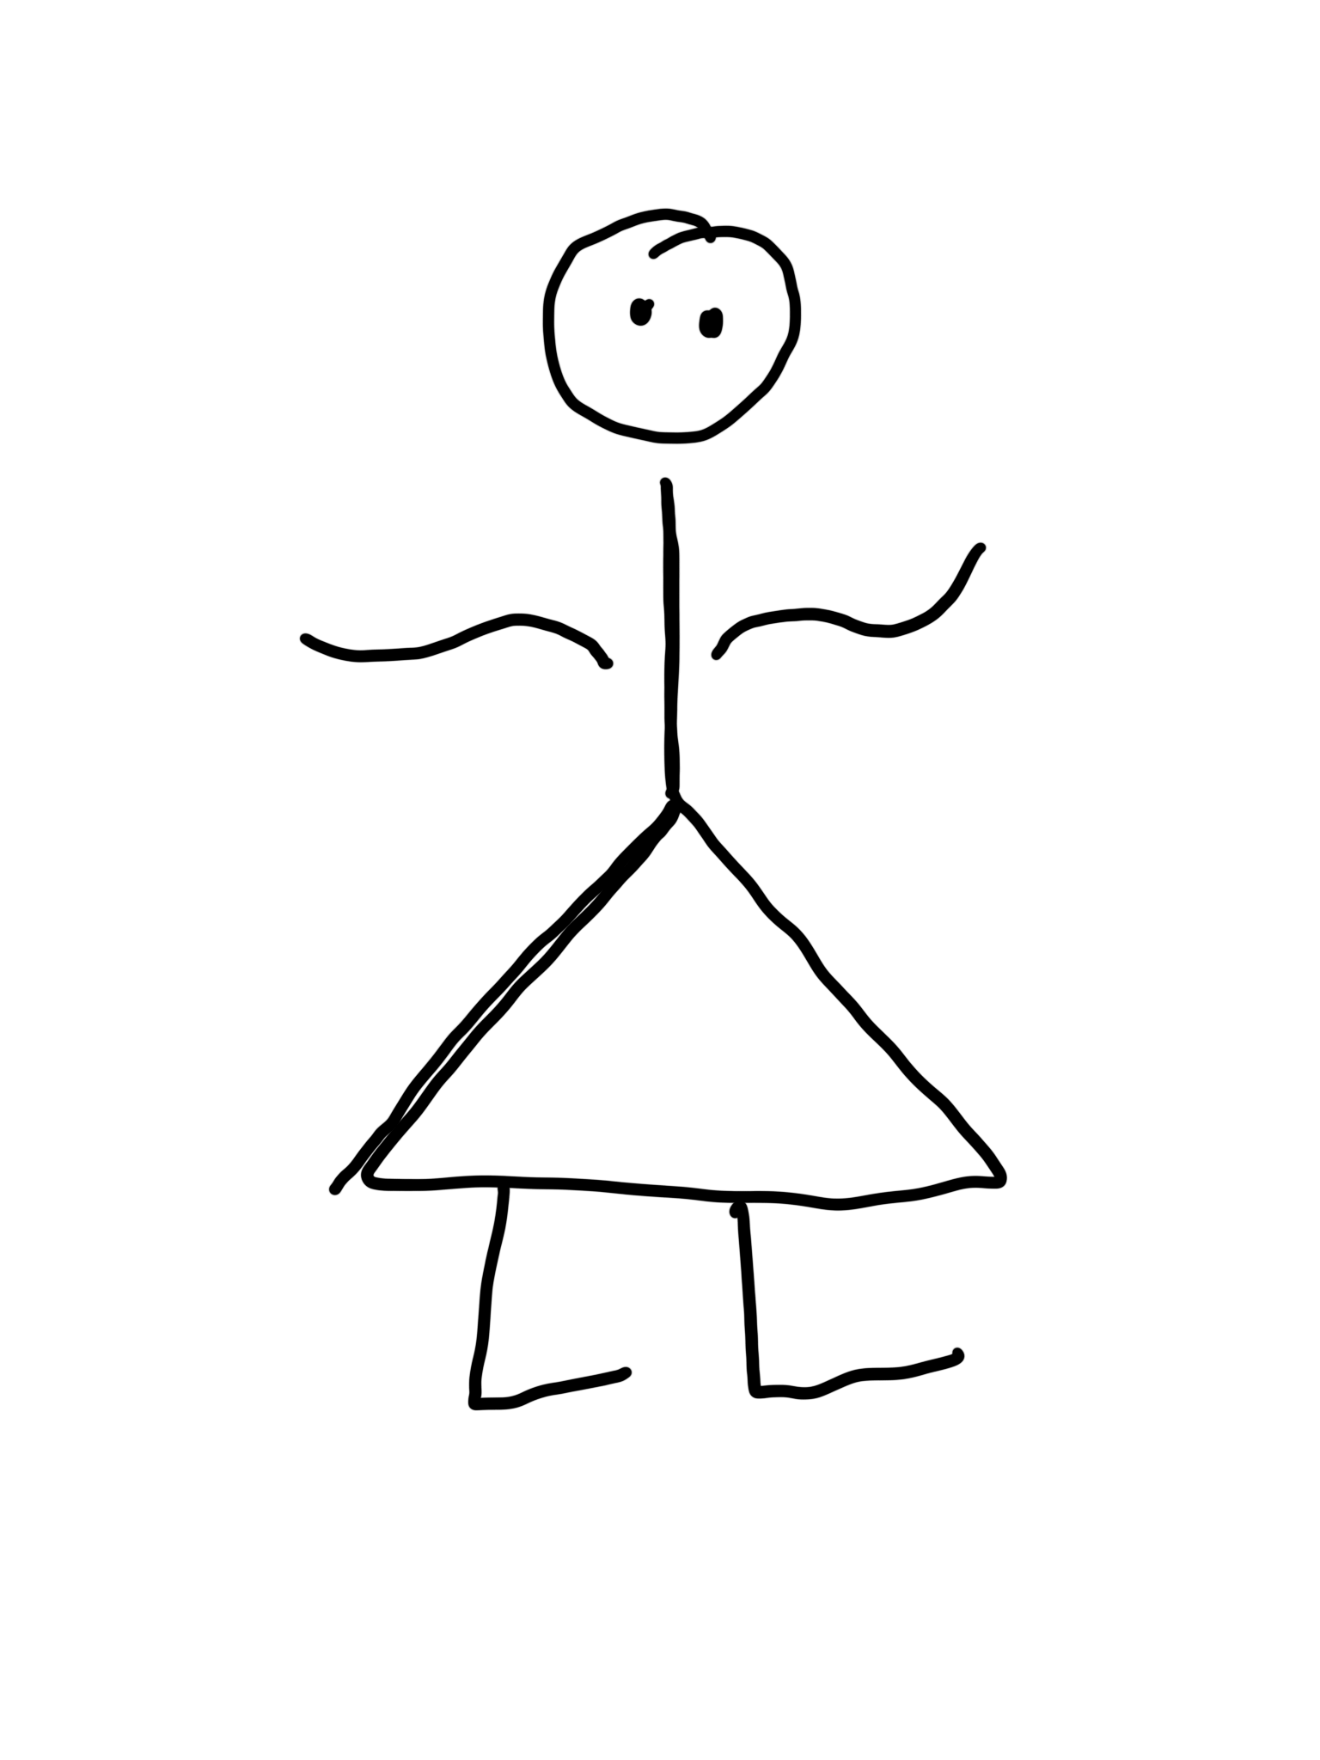
ATYANG
(Uganda)
This is Atyang Asia, a 12-year-old girl. Asia lives in very poor standards with poor feeding and bad shelter, in a slum. She lives with a stepmother and her father.
Asia was born okay. However, she was tortured by her stepmother. She was beaten and lost an eye as a result, now she is disabled.
She is a Catholic, but she is not allowed to go to church by the stepmother, due to much work like fetching water, sweeping the house, compound, washing clothes for the stepmother among others. Asia's stepmother takes her to work in other peoples’ gardens for a daily pay of UGX3000. When payment is made, her stepmother
takes it all, leaving Asia with no money.
Asia's friends are mostly boys. Because of her situation, Asia is always deceived by these boys that they will marry her and save her from the torture. But they end up sexually abusing her. She is a dark skinned, Muteso girl living in Busia. Because of her mistreatment, poor feeding and stress she goes through, she is thin and unable to gain weight. She is a catholic girl but unable to practise her faith because by the time she completes doing the home chores, the mass (catholic church prayers) is complete and ended.
Asia sometimes escapes from home and goes to the gold mines to pick and crush stones and get money, which she uses to buy some basic needs like sanitary pads because her stepmother does not provide her with such things. She would like to make friends, but she is not given time to do so because of the much work she does at home.

Slide 4
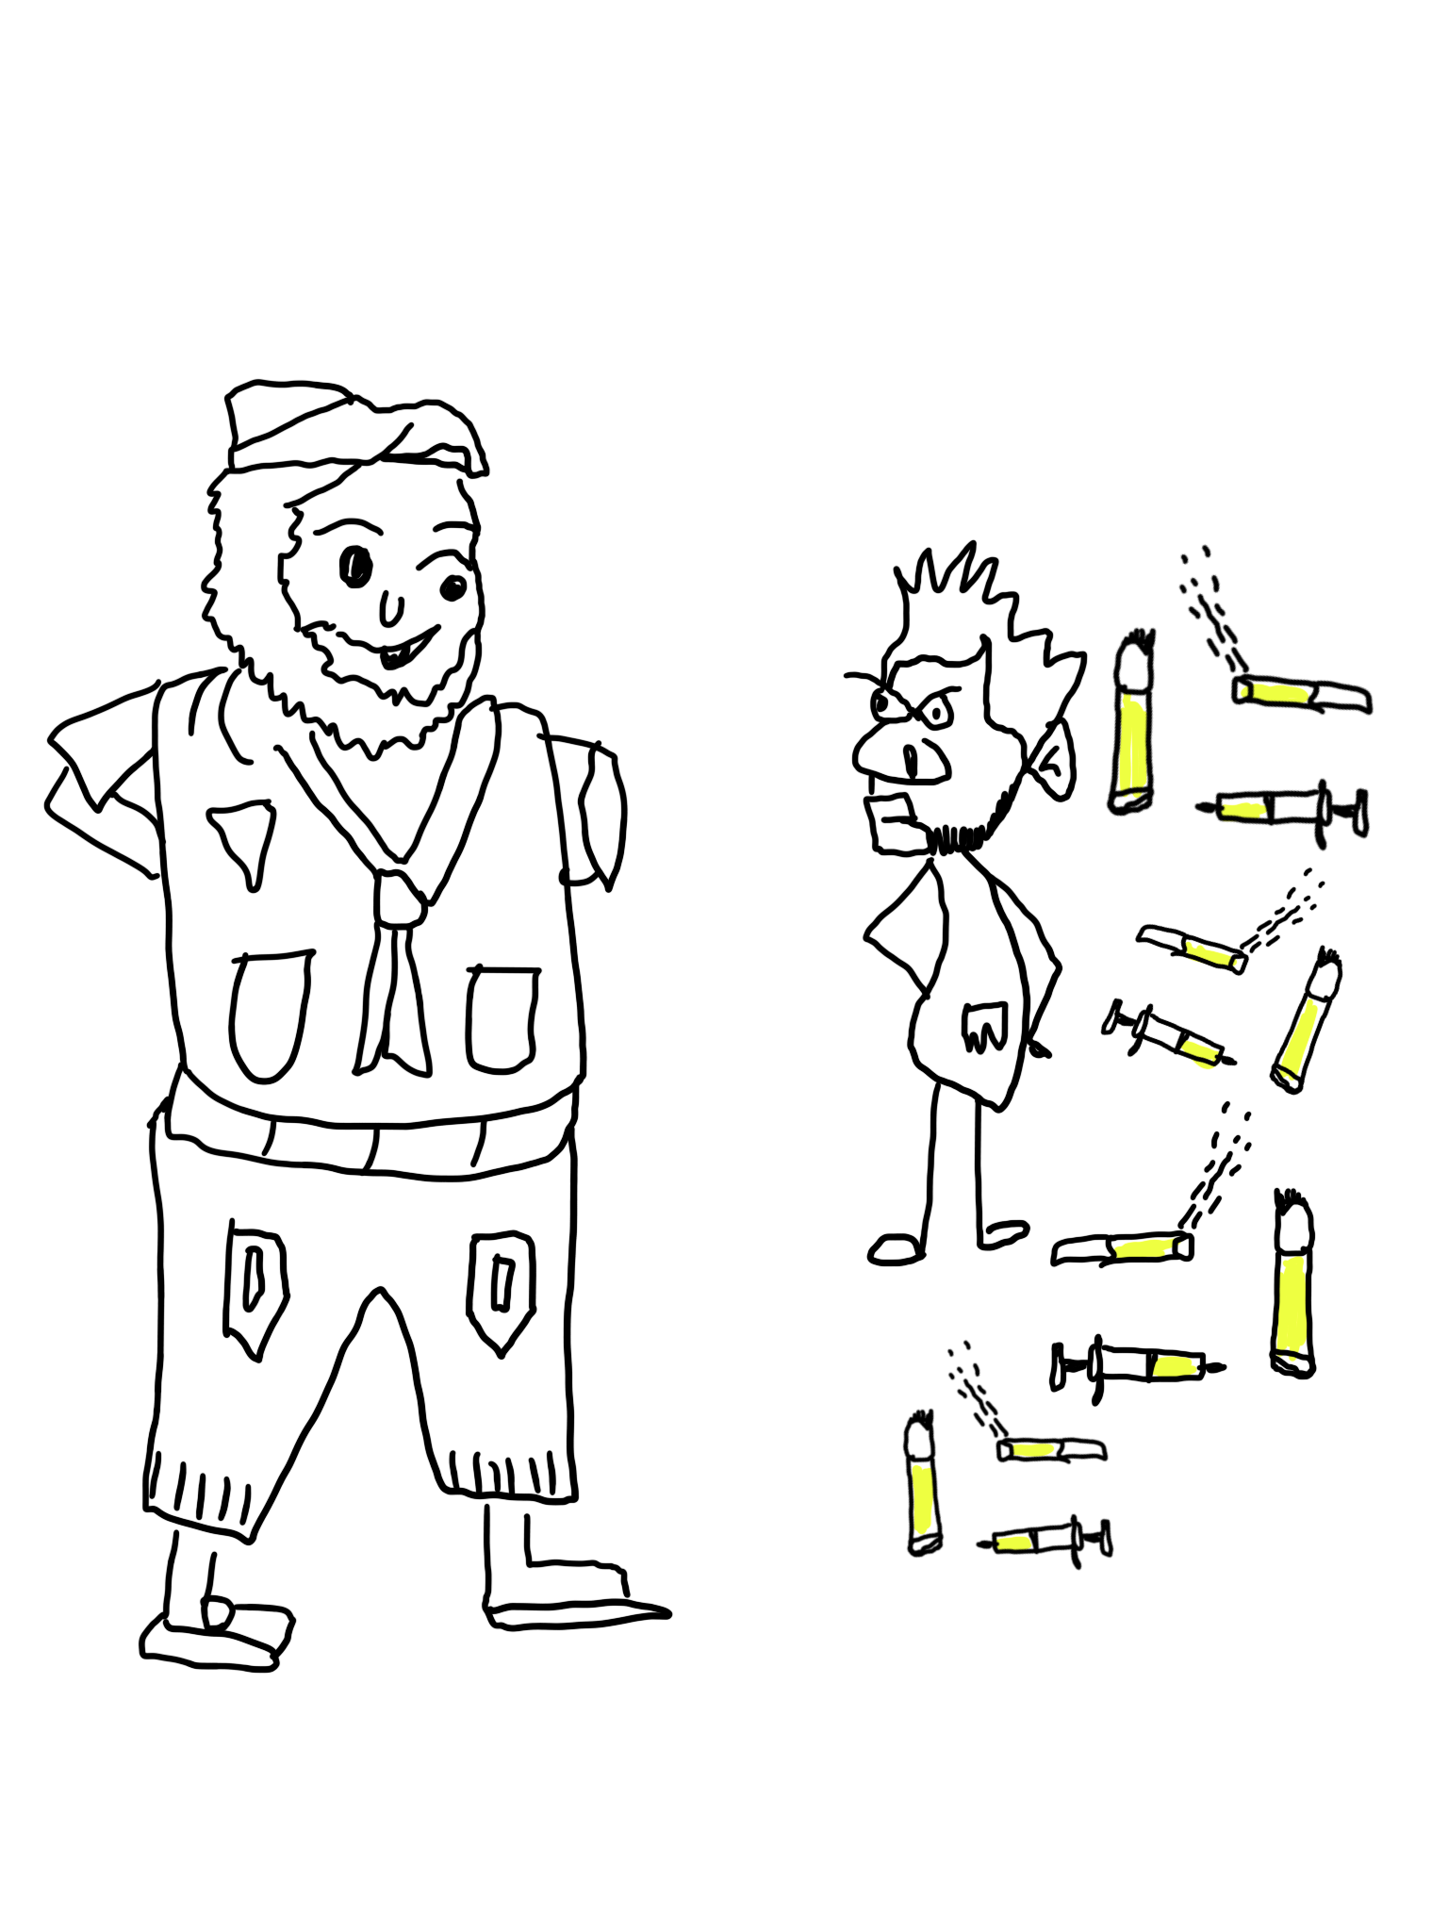
Ras
(Kenya)
Ras, is a desperate 19 years old youth back at his rural home in western province of Kenya. Ras lived with his old and poor parents and had dropped out of school due to lack of school fees. Ras survived by doing manual jobs until one day when his uncle who lived in Nairobi came for him with a promise of enrolling him in an international school in Wetlands, Nairobi. His uncle was a drug dealer and never enrolled him in school. Instead, he forced him to start peddling drugs citing that he had to earn his upkeep. He was taken to another location called Kayole in Nairobi to continue peddling drugs.
When life became unbearable, Ras escaped from his uncle’s house in Kangemi. He found himself in Kihoto, Naivasha where he was welcomed and joined a notorious gang in the informal settlement. Ras developed into a hard-core drug dealer at his young age; his other activities include breaking ins and burglaries at unsecured homes, muggings and other risky businesses. Ras has been in and out of police cells as usual with his ilk. Ras engages in sodomy which is high risk behaviour as this exposes him to HIV, STI as well as other health hazards. Ras is usually dirty and unkempt.

Slide 5
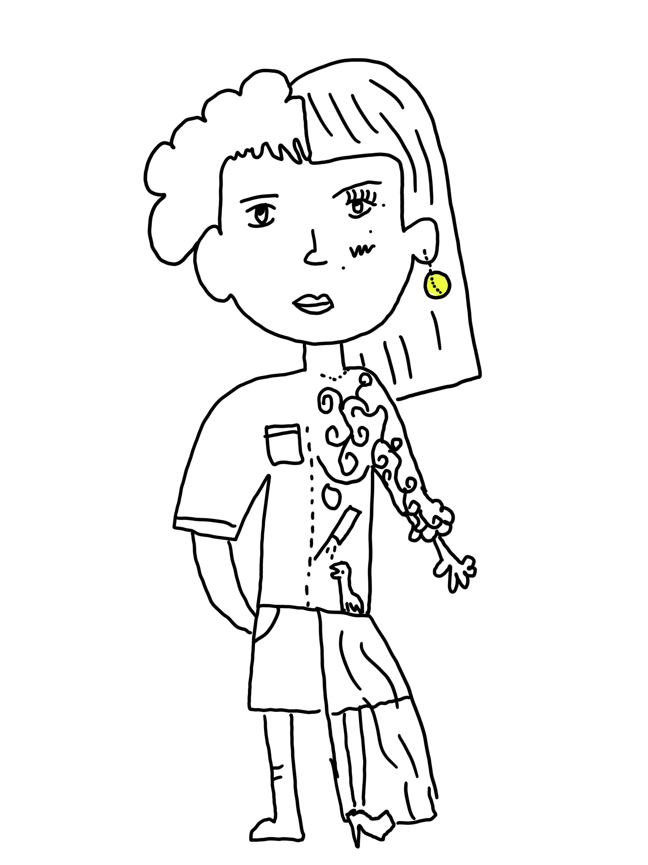
Lilly
(Thailand)
Lilly is a LGBTQ child from a middle-income family. She is 16 years old. She wants to become a dancer. Her parents always fought against each other. Lilly did not want to stay alone in her room. She did not want to see her parents fighting over things.
Her family did not accept her ambition/dream to become a dancer like Lisa, the K-pop star. Her friend said it was not possible because Lilly was gay and not beautiful.
Lilly posted her suffering story on her Facebook page because she did not know whom to talk to about this. One day, someone sent her a DM saying that she is talented. The man who contacted her said that he would introduce her to the great producer that works with Lisa. Lilly trusted him because he had a photo taken with Lisa on his profile. The man told Lilly to meet so that her dancing could be filmed. Once the video was released online, there were many Facebook followers.
Lilly received many comments both good and bad. Lilly was famous. The producer took some money from her income. Lilly only got 20%. Lilly was not herself anymore. She was depressed and ended her life with sleeping pills. “Meet wrong people brought you to wrong life”

Slide 6
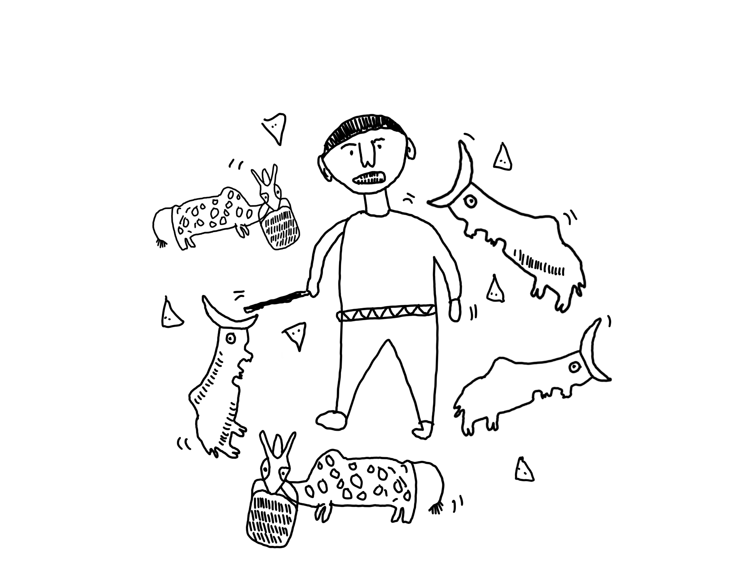
Rado
(Madagascar)
This is Rado. He’s 12 years old, tall and slim, black-skinned, smooth and short hair, and big teeth. He wears a red t-shirt, black shorts, and blue shoes. He has two sisters. They are a poor family living with their parents.
Usually, he goes out cattle-herding at 8am and brings no food with him. He comes back home at 6pm. The cattle are not theirs but owned by another person. In exchange for the herding, after a year of service, his family will get one cattle that they can sell afterwards to make money and they do this every year. He’s not happy though because he feels he doesn’t get anything out of it. He also wants to go to school but his parents refuse to let him go because he’s a source of income through the cattle-herding. One day he got shot on one of his legs by some bandits who stole the cattle, he was herding by the mountains.

Slide 7
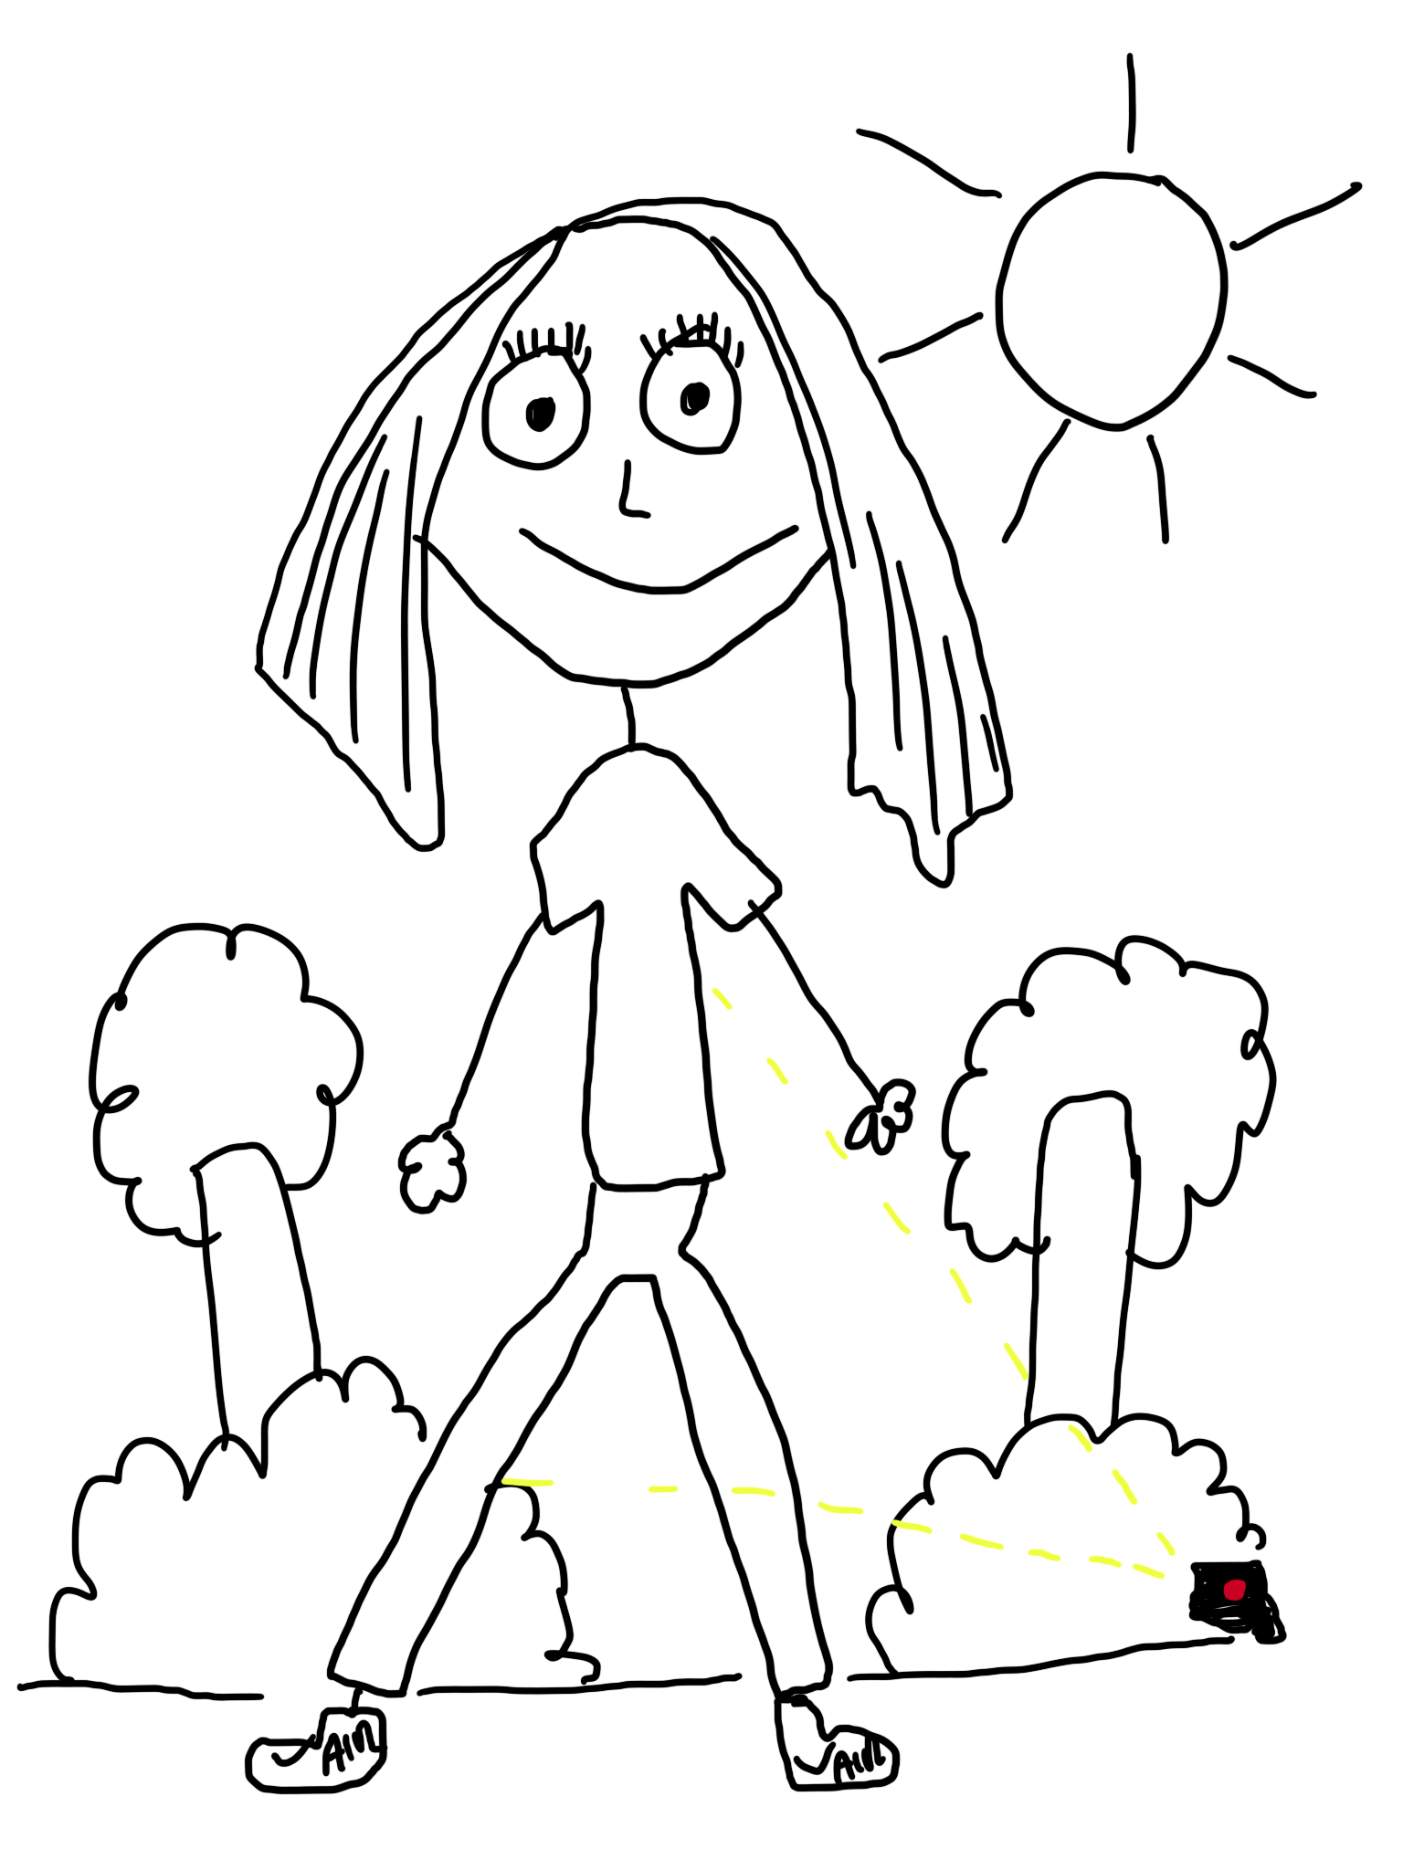
Sarah
(Moldova)
This girl is Sarah. She is a healthy girl. She has not tried alcohol or smoking yet. She is 15 years old. She has recently moved from a small village to the city. She is not from a rich family but she is not from a poor family and she can afford good food and normal clothes but not very expensive. She is beautiful, very tall and well-fitted so she can be a target for forced labour. There is a camera in the picture watching her. Someone has specially installed a camera to watch her. She is from Moldova but at the moment she is living in Germany with her family. Sarah goes to school. She lives with her parents and they came to Germany because her parents found better-paying jobs here.

Slide 8
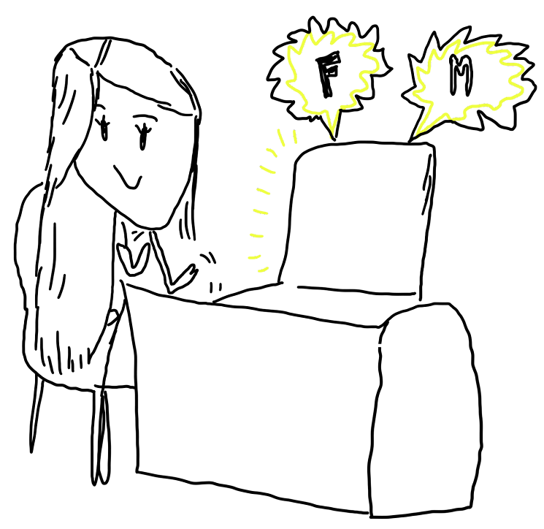
Lina
(Cambodia)
Lina is a 14 years old girl. She was born in a good family but her parents also keep busy with working , they do not have much time for her. Mostly she spends a lot of her time on social media chatting or watching videos. Until one day Lina meets one boy online and develops a love relationship with that boy, but she never meets him face to face and she doesn’t know what he looks like outside. Until, one day that man requested her to send her intimate picture and Lina rejected but that man kept grooming her as he said if Lina truly loves him , she will send the picture as she doesn’t want him to get upset so she decided to share one of her pictures. After getting the picture, I keep asking for more pictures from day to day. Lina starts to feel that it is not love and she feels she was exploited so she decided to ask that man to break up. But the story does not end here. After she asked to break up, that guy started threatening her that he would post her pictures on social media, which made Lina feel very stressed and she didn’t dare to talk about it with her parents.

Slide 9
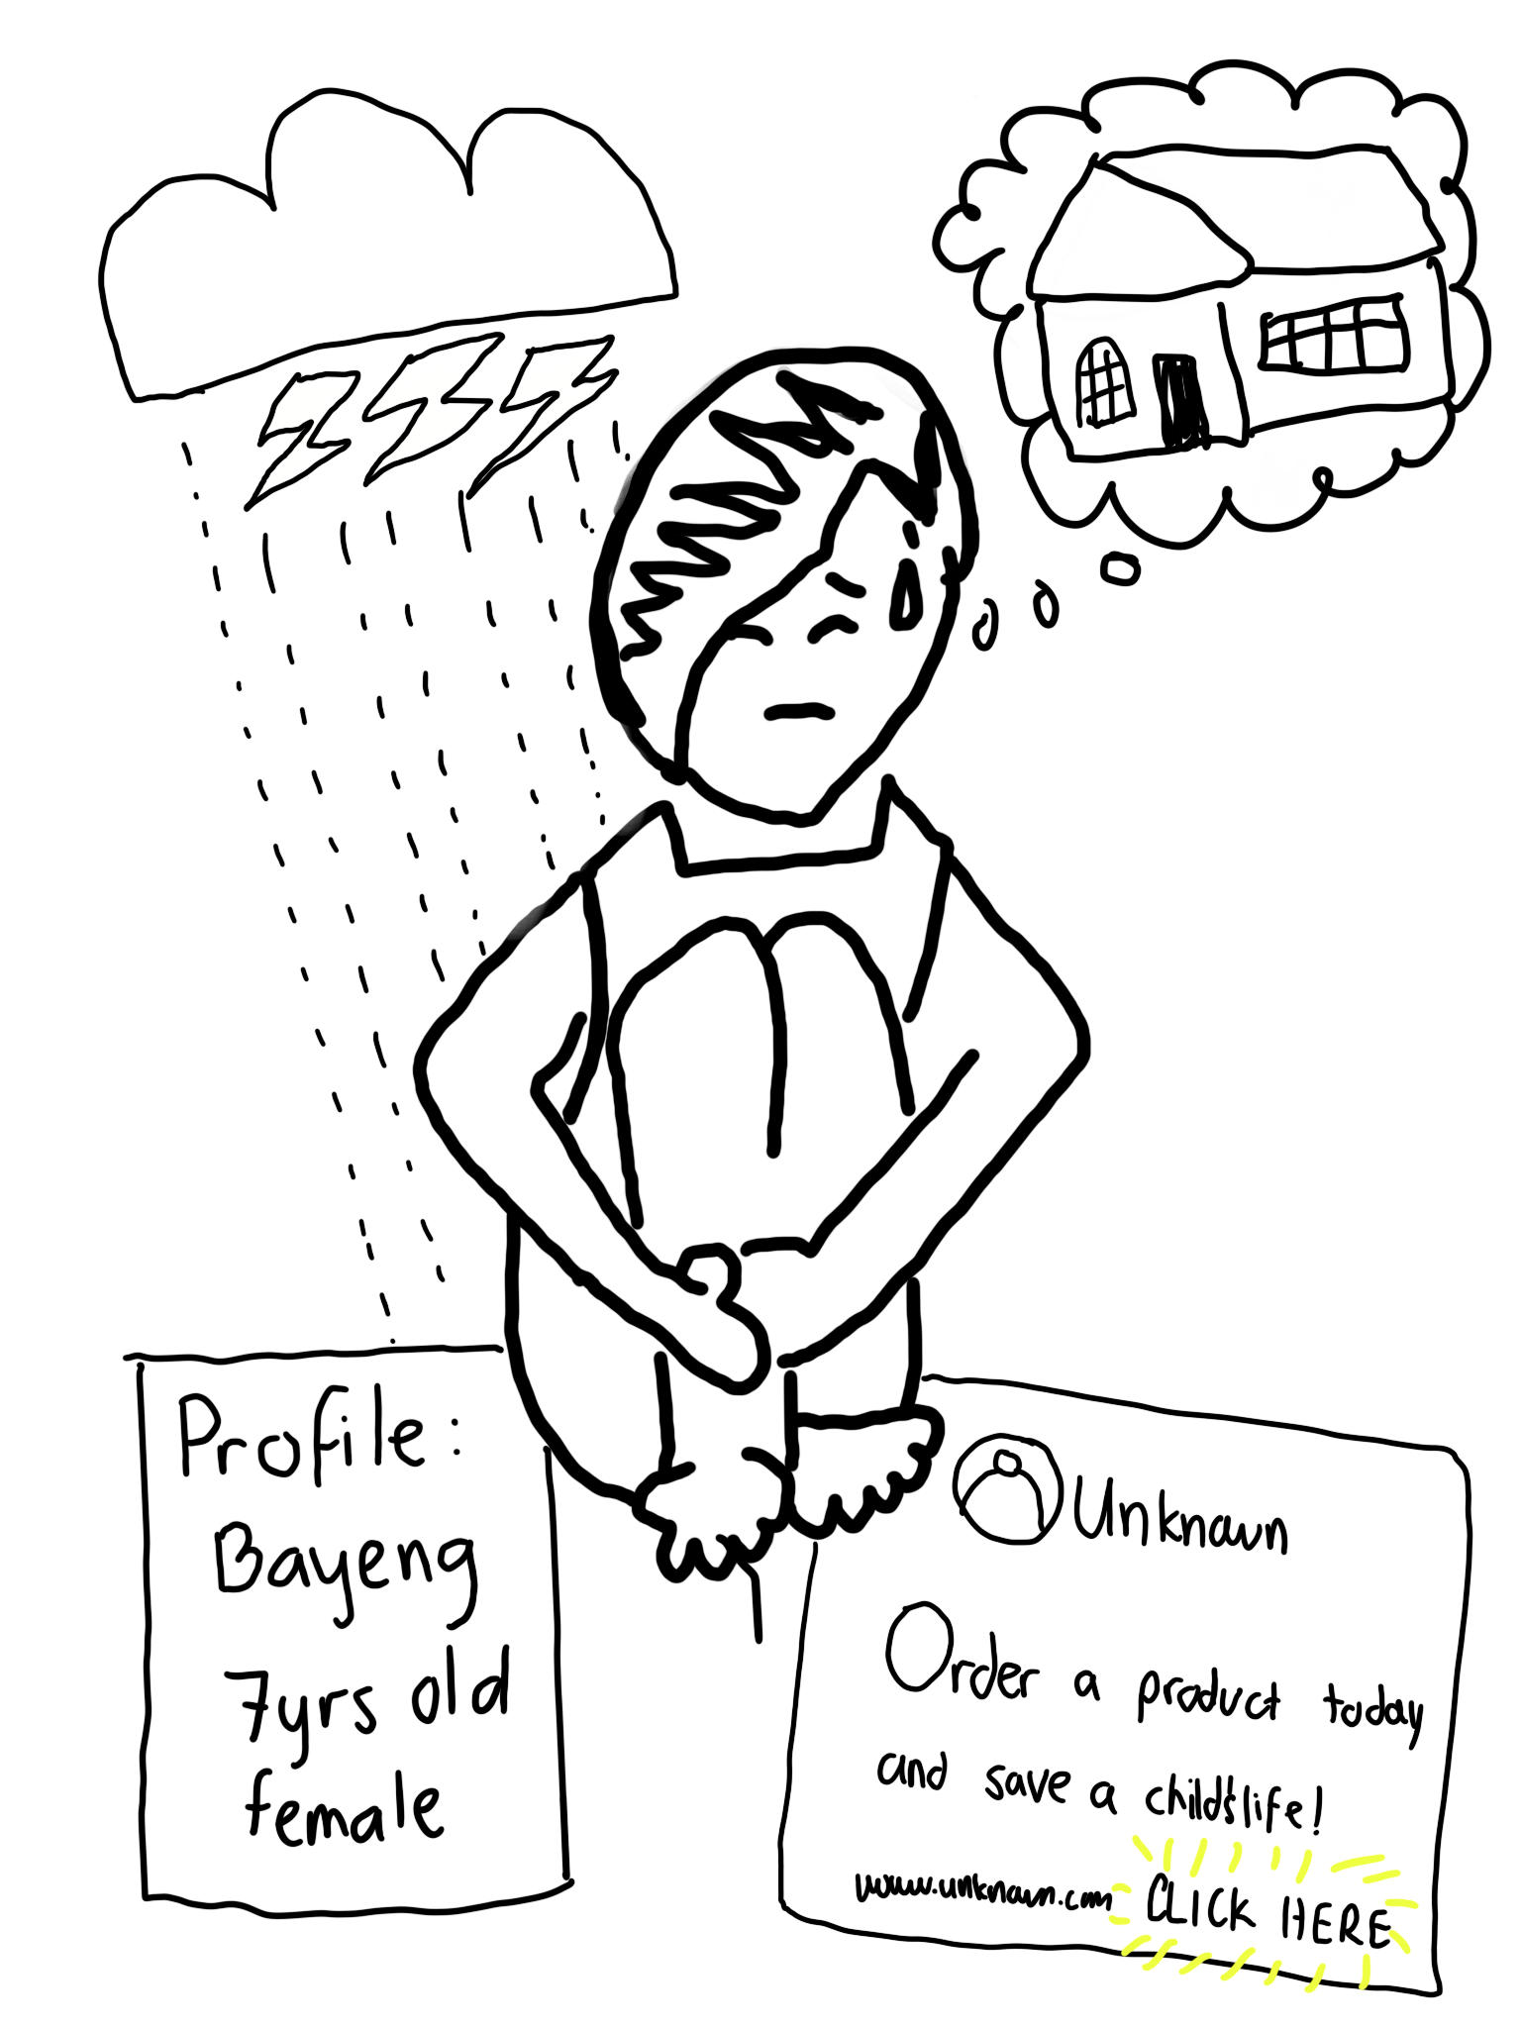
Bayeng
(Philippines)
This is an advertisement. If you can see here, it says "Unknown," "Order a product today and save a child's life." So, as you can see, this child is depicted in a situation where there is a disaster. And this child is thinking, they are in a situation where they need a place to stay. An unknown person uploaded her picture like this and was like, "Order a product today and save a child's life." It's as if they are using her to advertise their product. But what she actually wanted was to get her picture because in exchange, she would have a place to stay, they would help her and all that. Yes, they did help her, gave her a place to stay, but the place where she stayed was not safe emotionally and physically. She was being exploited, and they used her for human trafficking. They were selling her pictures online and all that. So yeah, we found it, right? We found it. Terre des Hommes, we found it online, and we thought, "This is not good, it's bad." So, we took action and did our best to help every child exploited by the unknown person. So now, there are no more. It's because of her backstory. Now the children are in safe and happy places.

Slide 10
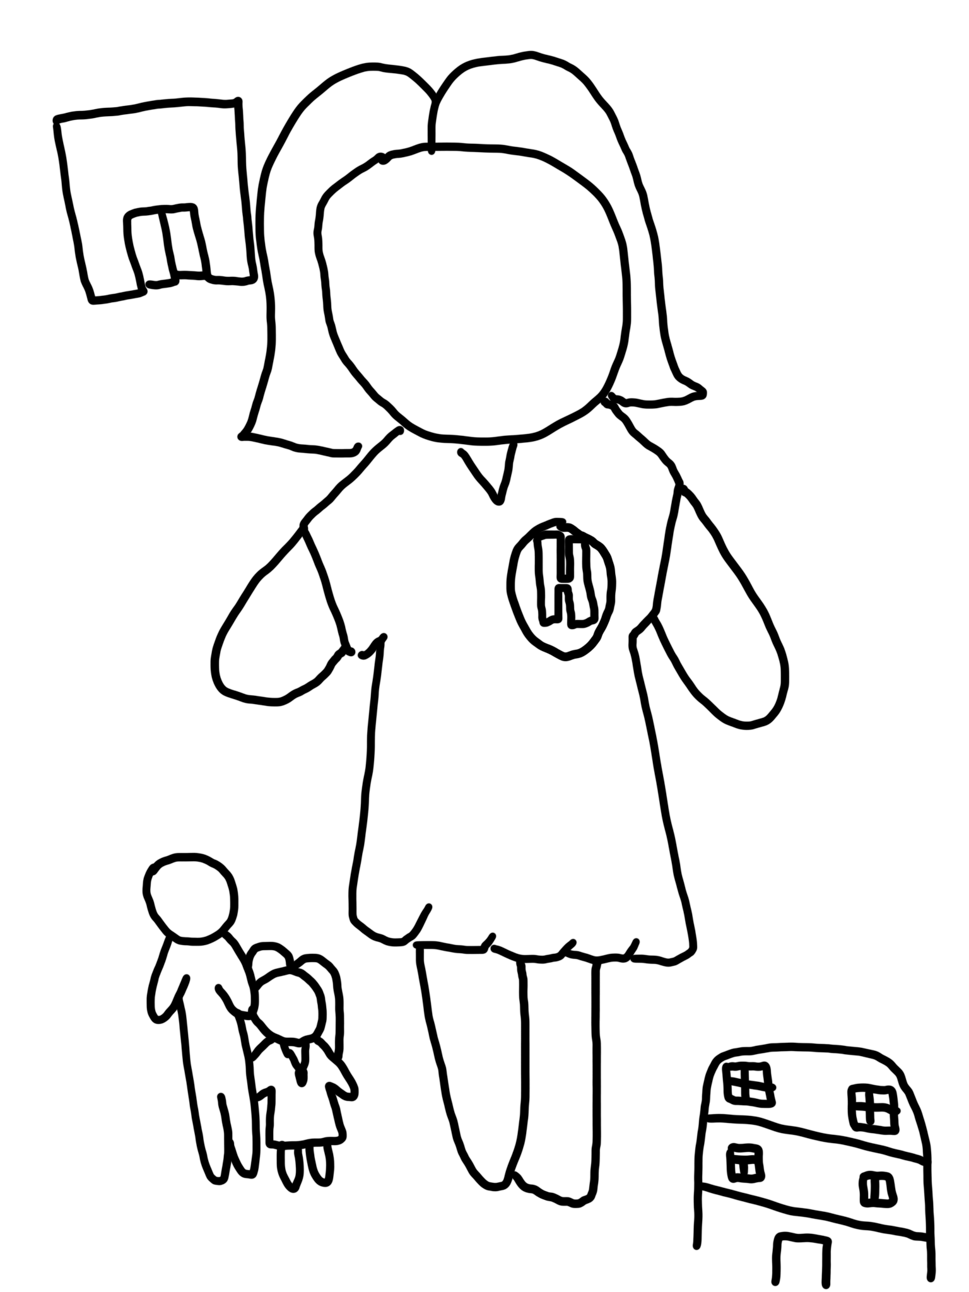
Hana
(Philippines)
Hana is an orphan girl who thought that she no longer had family but one day, she met her uncle with whom she stayed with. After some time living with her uncle, Hana started to feel that she was being harassed. Her uncle watched her while she was bathing, and she was also abused sexually. She left her uncle's house because she couldn’t take the abuse anymore.
She met a woman vendor in the market. The woman asked her if Hana wanted a job, she said yes. The woman told Hana that she needed to go with the woman, although hesitant, she went with her in the end. The woman turned out to be a pimp and everything that Hana earned went to the woman.
There was a typhoon when she ran away. She went to an evacuation centre and asked for help, but instead of getting help, her uncle saw her again at the centre and she was forced to beg for anything. She resorted to selling anything, she even sold her body on Facebook so she could eat. She continued to live that way, and since then, nothing has been heard about her again.”

Slide 11
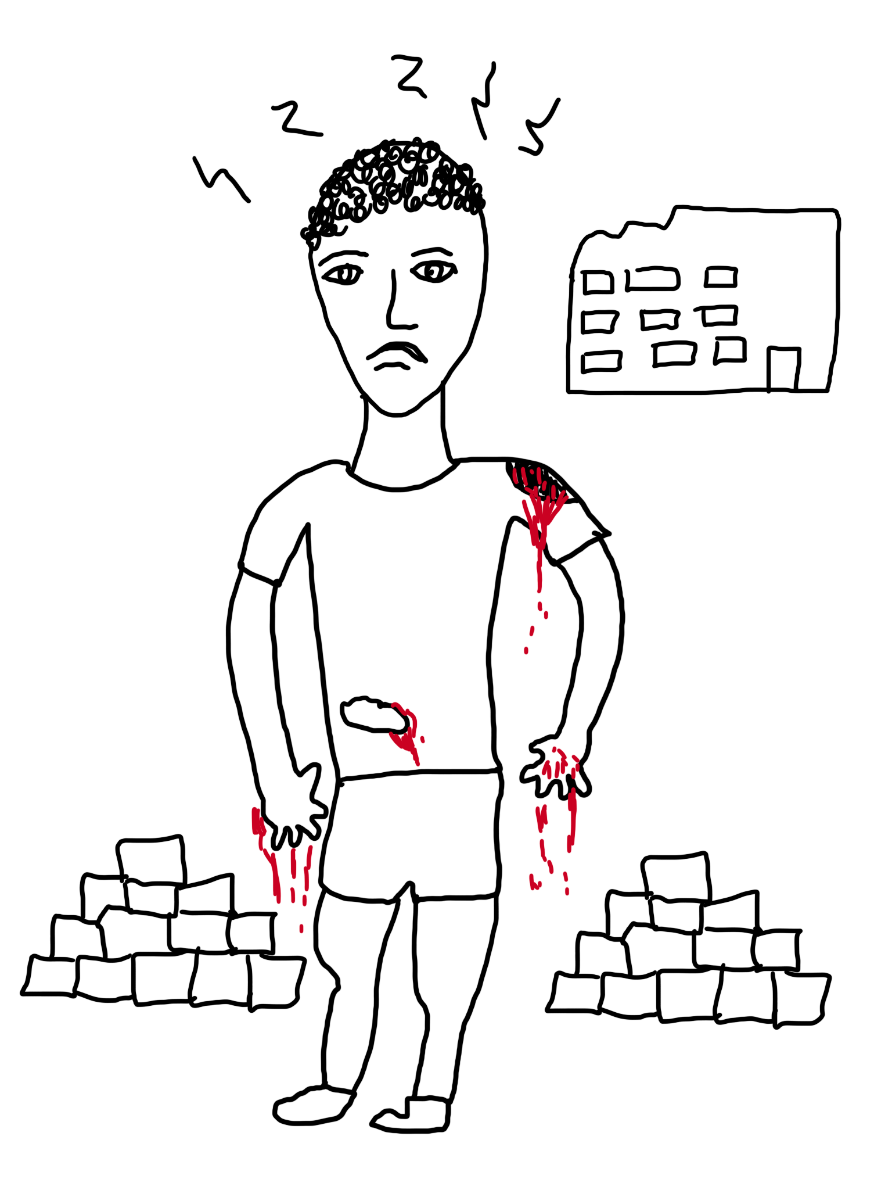
George
(Moldova)
This is George, he often goes hungry, lives without parents, suffers from bullying, insomnia, and has health problems. He is bullied and since he works on construction sites and is often hungry and tired quickly because he is forced to do jobs that are not appropriate for his age, his hands cannot stand and bleed.
George is being forced to work, and lives in the city, but they sent him to work in the woods so no one would see him being abused and no one could help him. He does not go to school. He has to work and build this building. He looks sad, he's moody and upset because he's under pressure.

Slide 12
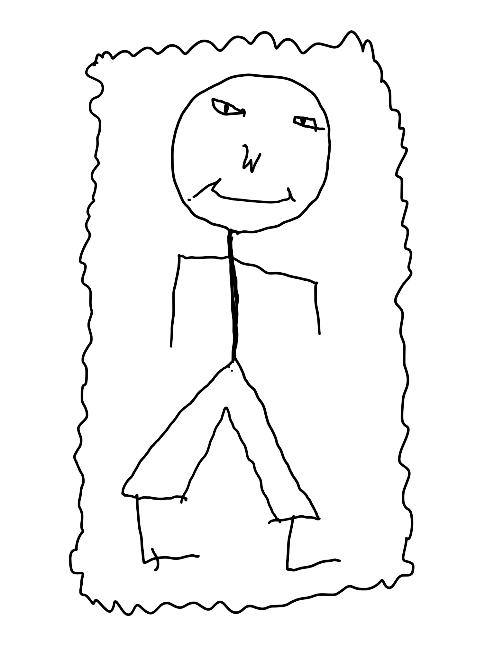
Lopeyok
(Uganda)
This is Lopeyok, a 15-year-old boy. Lopeyok means visitor.
Lopeyok is the head of a family where he lives with his brothers and sisters in a grass thatched house. He became the head of this family after his parents died. He hustles a lot to fend for his family. He works in a mining site with workmates who are both adults and children. He was born with HIV, a virus that caused the death of his parents. He is a born again Christian.
From the hustles, he earns very little money. He is not able to pay his school dues, hence, he is not in school. He has some friends who are mostly boys.
Lopeyok is a dark skinned, slim bodied Karamojong. He is hardworking and also participates in cattle raiding which is common in his community. He owns and knows how to shoot a gun which he uses during raids.
He is rude when provoked and is always on the move from one place to another looking for work. During his leisure time, he also enjoys dancing the local dance (Edonga) while jumping.

Slide 13
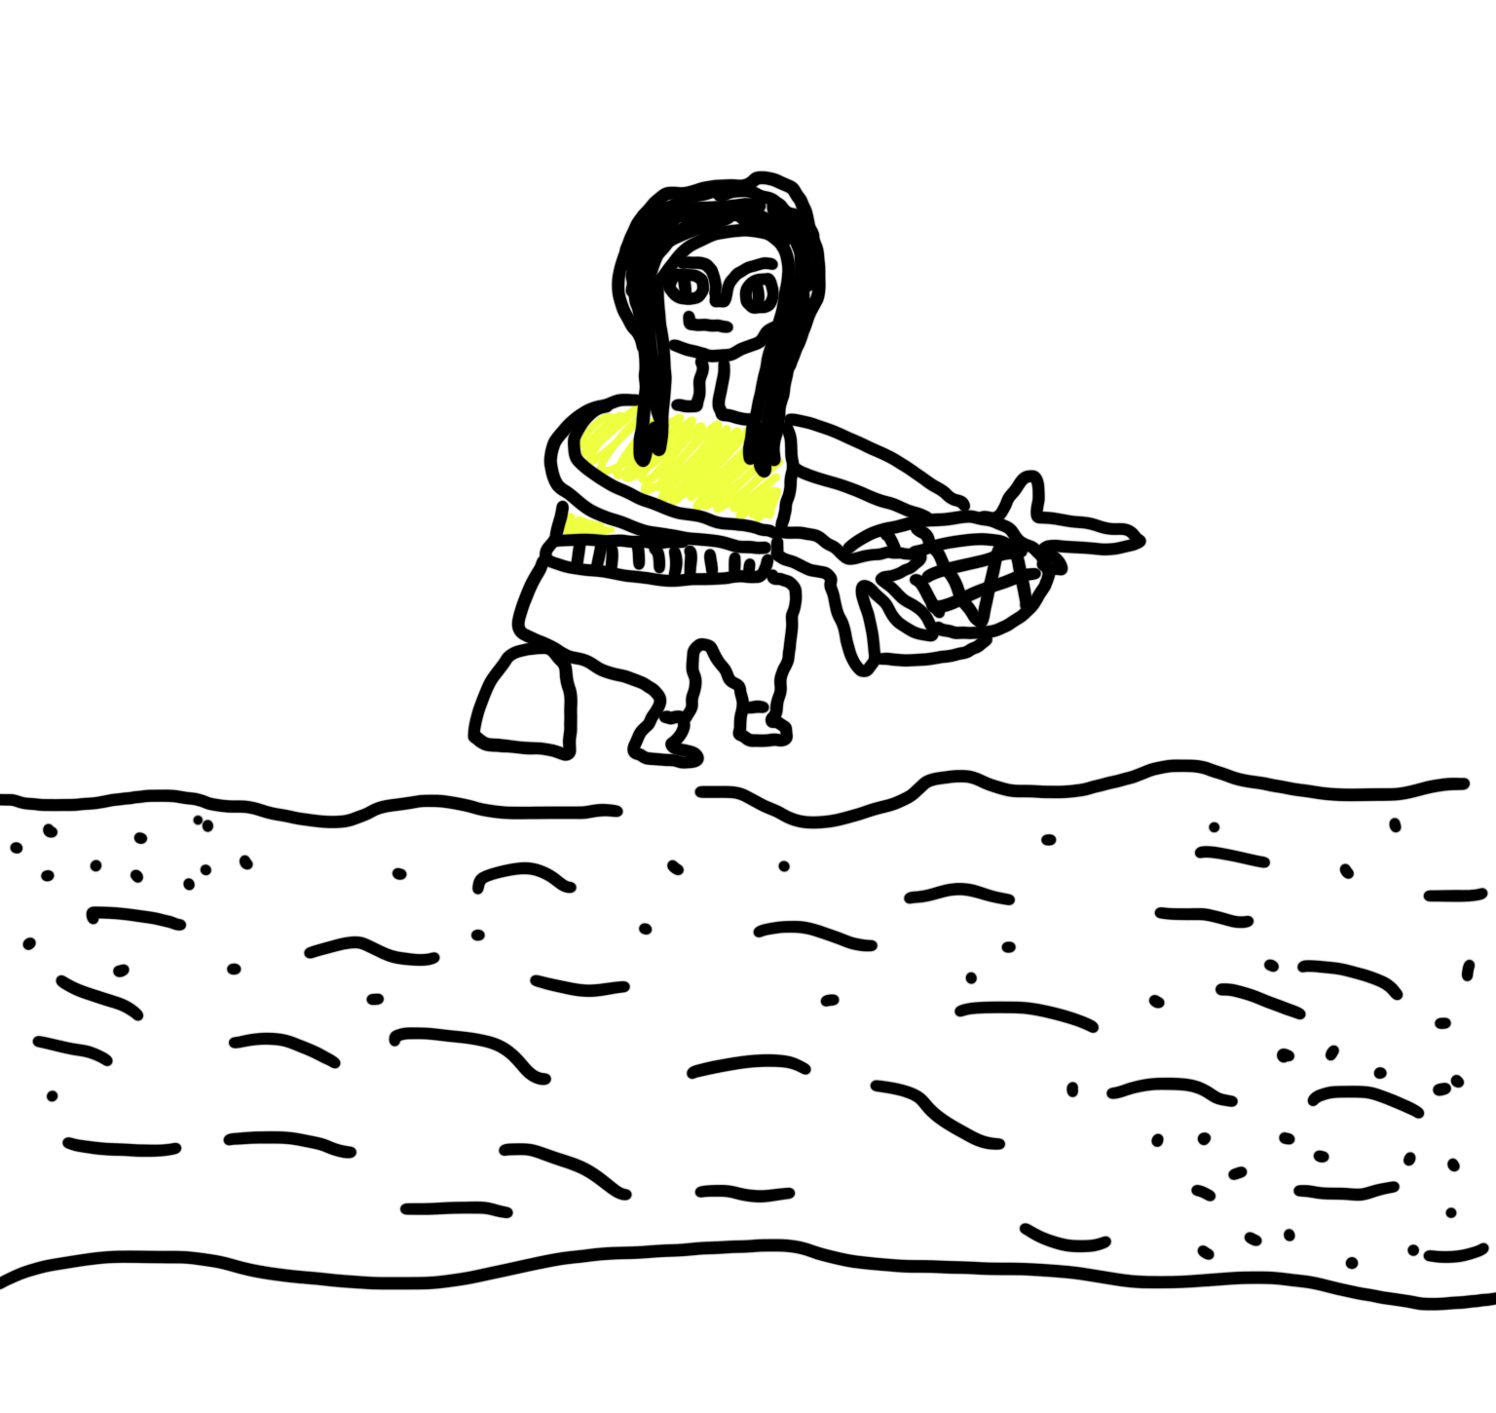
Maisina
(Madagascar)
This new friend of ours is called “Misaina” meaning ‘thoughtful’ or ‘thinking’. She’s a tall and big 12-year- old girl, has a small head, big eyes, long black hair, white-skinned. She wears a yellow t-shirt, red trousers, green hat, and no shoes. She’s the first child of their parents’ five children and they are also orphans.
She wants to go to school and play with her peers but has no parents to support and she feels sad about that. To earn money so that she can have lunch and dinner every day. She works for people by washing their clothes and makes 0.04 euro per cloth. But this causes her to feel tired every day and falls sick. She wants to seek a healthcare service, but she doesn’t have any money for that.

Slide 14
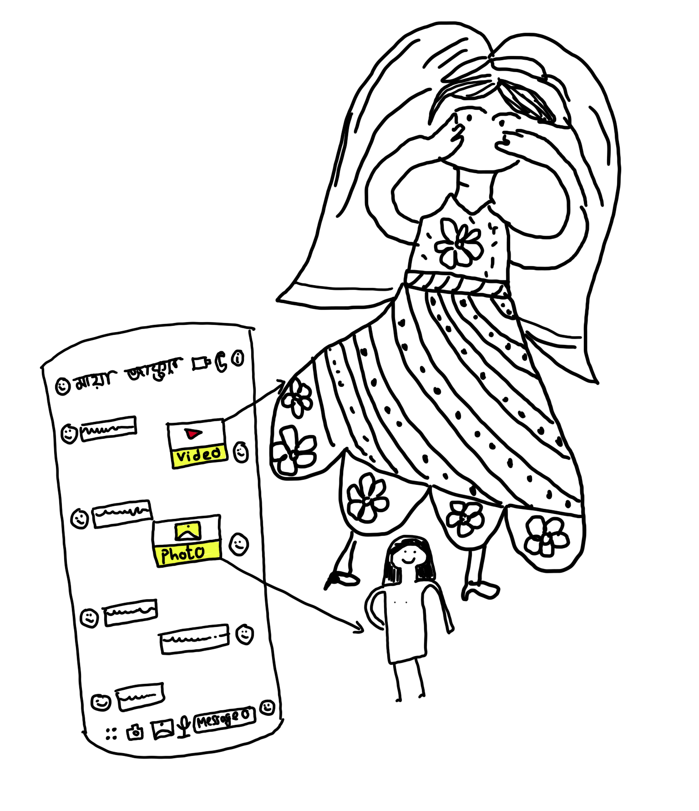
Maya
(Bangladesh)
Maya is a 15-year-old girl, who reads in class nine. She belongs to a well-off family. Her father is a businessman, and her mother is a teacher of a reputed high school in Dhaka city. She is a good student, and always gets good marks in the exam. Mitu is her best friend, who reads in the same class, and both go to and come from the school together. Maya and Mitu, both have smartphones, and they are habituated to operate their Facebook accounts. During the weekend, they stay at home and go on the internet to operate Facebook. Sometimes, whenever they feel lonely, they want to make new friends so to try to make new friends, they start to use chat rooms and add themselves in different groups. They speak to different kinds of people on these chat rooms and groups, and many of them are much older than them. After a period, the people grooming them, the conversations quickly turned from kind, caring and understanding messages to controlling and sexually explicit messages. But they always ignored the sexually explicit message and couldn't try to reply to the messages. However, sometimes they speak to these people online, through texts and the occasional phone.
One day, when Maya started to operate her Facebook, she observed that she had been added to a depraved group by someone where naked pictures of boys and girls, sexual videos and sexually explicit messages were available. At first she was scared after seeing the sexual materials. Suddenly she noticed that one of the naked pictures of her friend Mitu had been posted by someone in the group by editing with Artificial Intelligence (AI) technology. She was more scared and afraid after seeing the naked picture. That night she wasn't able to sleep. The next day, whenever she met with Mitu at school, she asked her about the group, but Mitu ignored that she did not know about the group.
Later, she described all the matter with Mitu, and like Maya, Mitu also felt scared, nervous, confused and afraid. After returning from the school, Mitu shared everything with her mother Sharna Begum. At first, Sharna Begum did not believe the incident, but after checking Mitu's facebook she confirmed that her daughter had fallen into a trap. She also observed that someone sent a message to Mitu asking for a real naked picture. Without delay, Sharna Begum goes to the police station and informs them about the whole matter. A child abuse case was also filed in the police station. Through a prompt investigation by the police cybercrime prevention unit, the perpetrators were arrested under cybercrime, and sent to the court for punishment. The honourable court gave the perpetrators seven years prisonment.

Slide 15
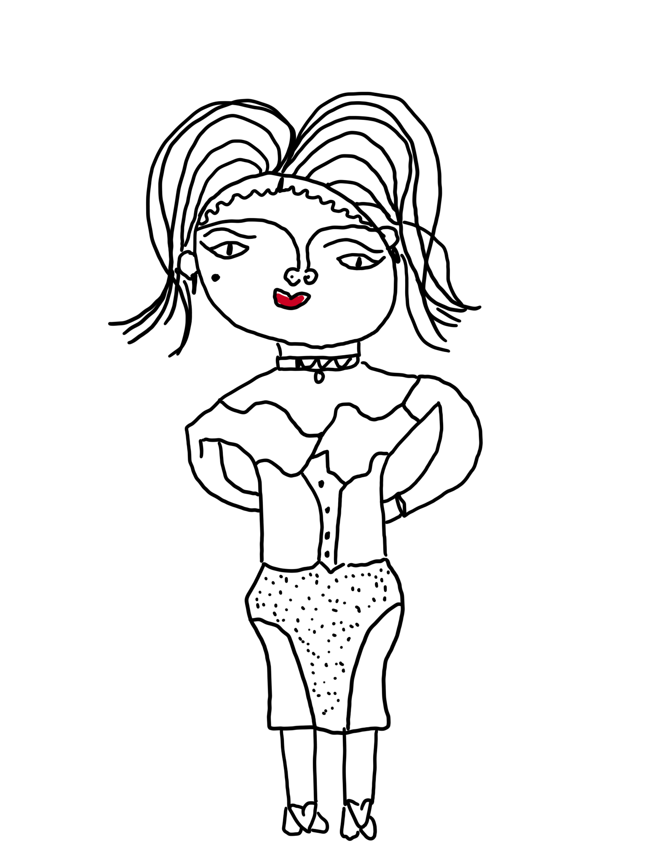
Monicah
(Kenya)
This is Monicah, a 16 years old girl originally from Thika in Kiambu County. Monicah is a naïve church girl from a humble background who was brought to Gilgil by her uncle after she sat her KCSE exams in 2022 in the pretext that he had found a college placement for her, yet he had other ideas. The uncle received money from agents who trafficked the young girl to Qatar with a promise of good earnings and hence savings for investment back home.
The information from Qatar is that Monicah is in distress; she is suffering unending sexual abuse, perpetual physical abuse, a meagre salary unlike she was promised, she has no medical cover while her health condition is deteriorating daily. Monicah has asked to be rescued but instead she’s on the list of those to be deported meaning she will lose any accruing benefits owed her.

Slide 16
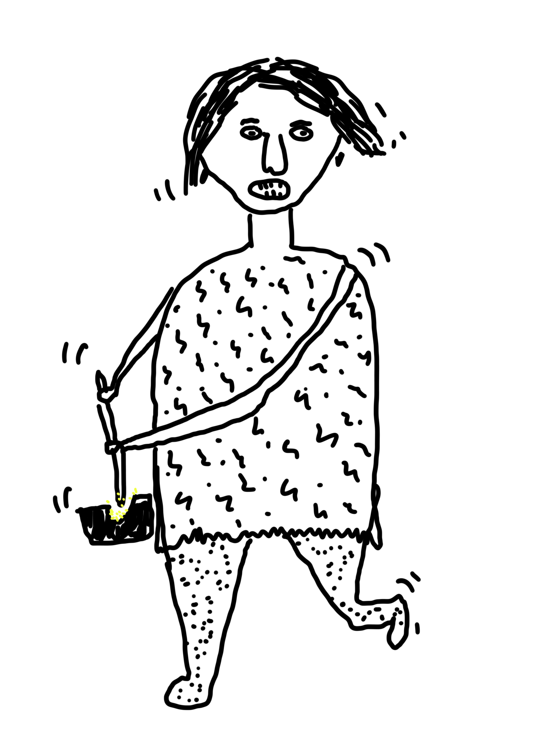
Soanevia
(Madagascar)
The third friend created by the children is “Soanevia” which is another way to say ‘Tongasoa’ which means ‘welcome’. A big and short 14 year old girl with long hair, big eyes, big nose and big mouth. She lives with her poor family of seven children and their parents. She’s also a child with disability and has difficulty walking because a car ran over her.
She’s the second child. Like her older brother who is 17, she is out of school. Her younger siblings go to school and have lunch at the school canteen. Usually, the family only has dinner at home. Because Soanevia wants to have lunch, she works for people by pounding rice and getting rid of the covers. In total she gets around 2.15 euro in a month. She is sad because if she could, she would rather use the money to buy clothes rather than buying food.

Slide 17
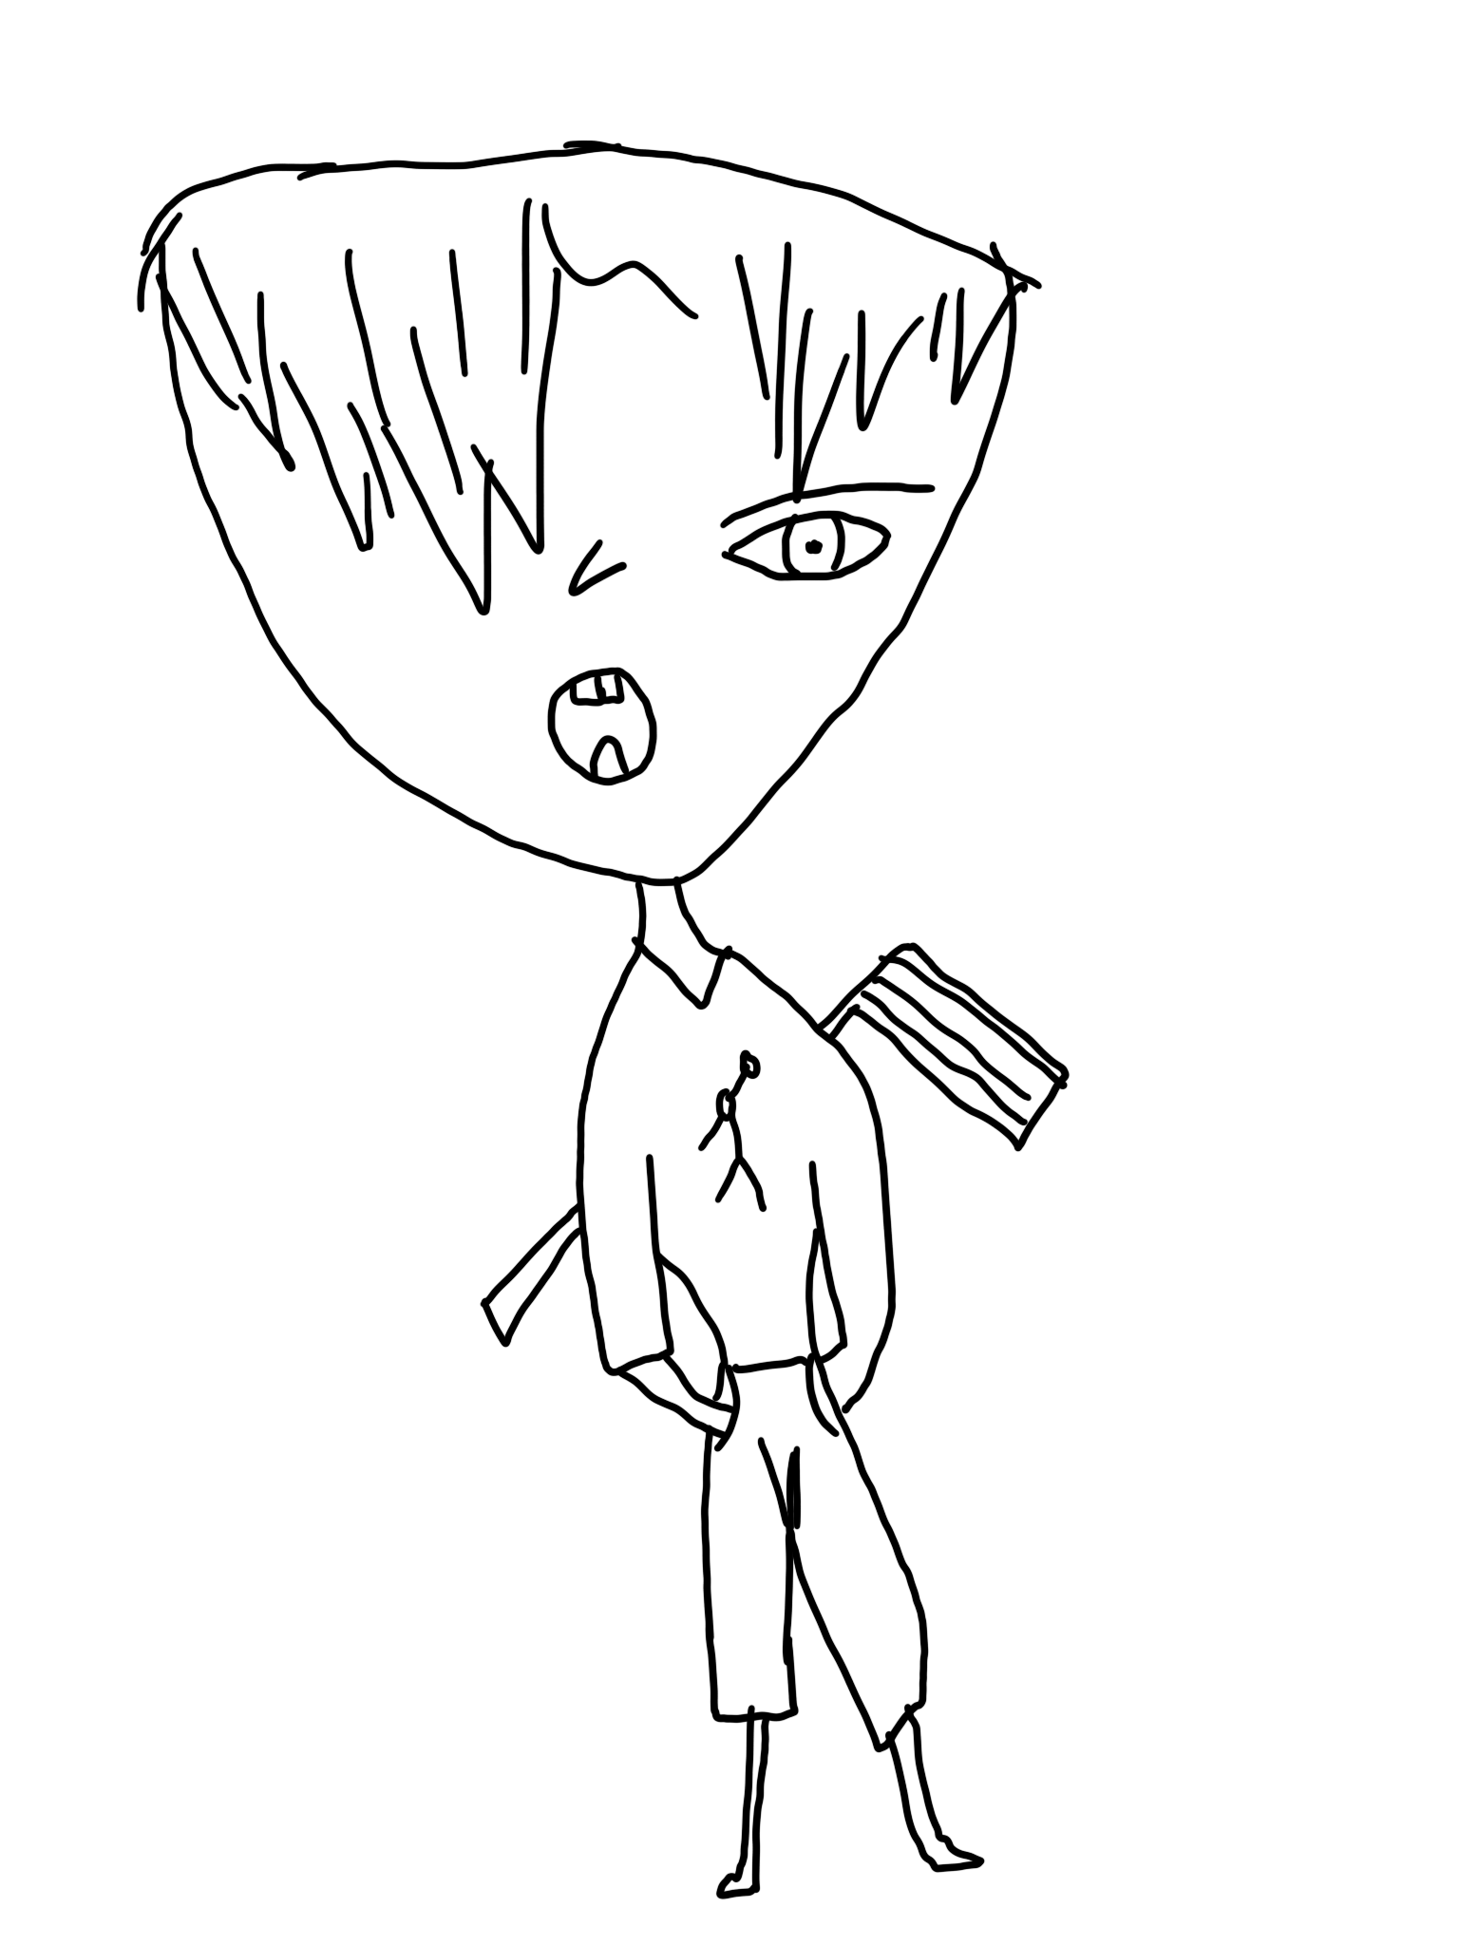
Tar
(Thailand)
Tar is a 14 years old boy. He is autistic, slow and always bullied by his peers. He has no one to talk to. His family is poor. Tar collects waste (plastic bottles) to earn money. He lives with his grandparents. He has no father or mother. His grandpa has Alzheimer. His grandma is a seller. Tar is being bullied every day.
He always gets trapped because he trusts people. One day, a senior friend told his grandparents about a part time job – cleaning a rich lady’s house. The lady provided 300 Baht a day but the senior friend told Tar and his grandparents that the lady would give 200 Baht a day. Tar wanted to earn money to help his grandparents, so he went to work with the lady. It was hard work. The lady’s house is huge. She is bossy and hurts him both verbally and physically.

Slide 18
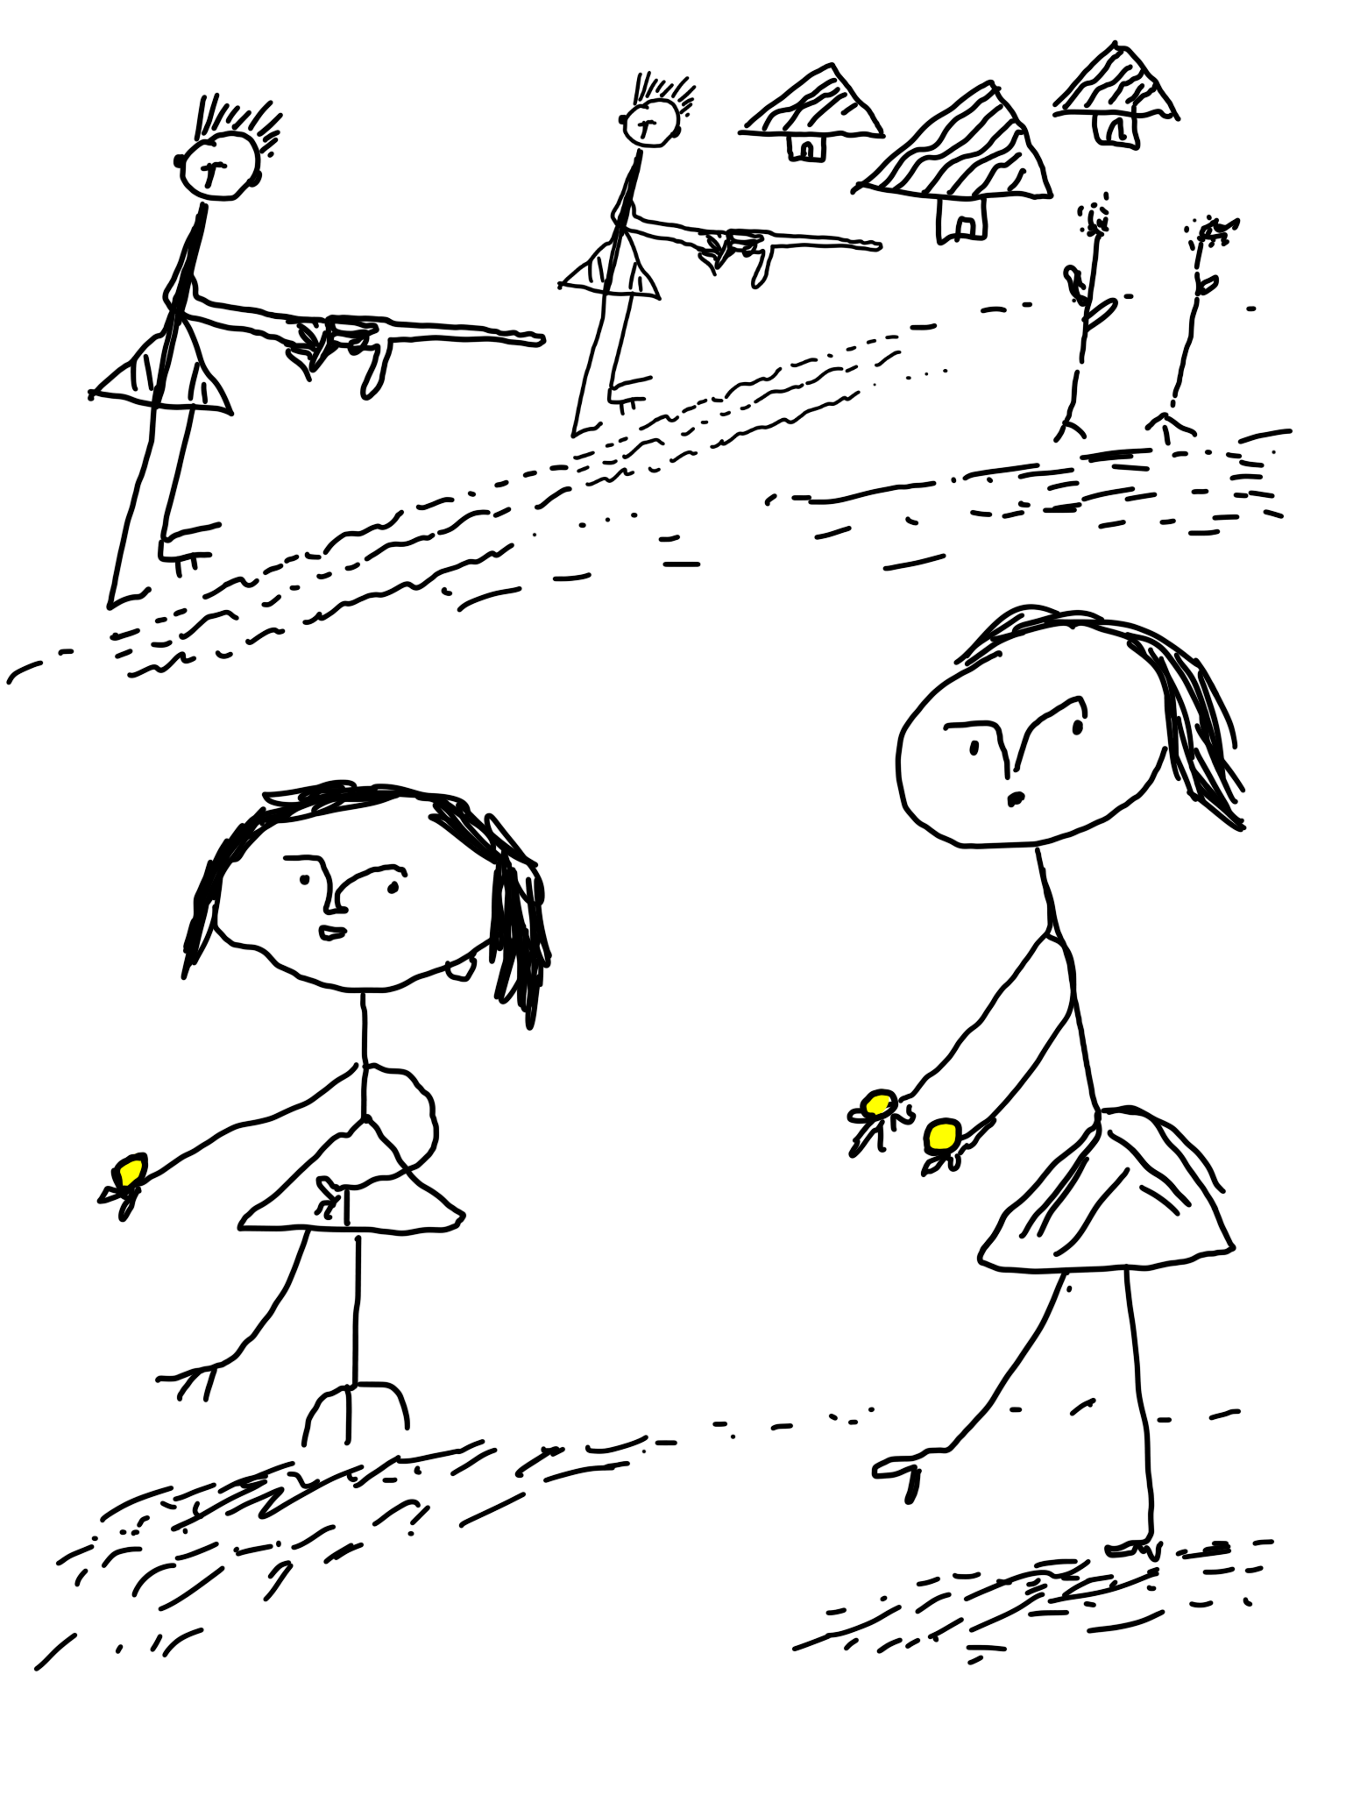
Tarikwa
(Ethiopia)
Tarikwa is a 16 years old girl who lives with her mother. Tarikwa and her parents used to live In Dano in the Oromia region, and they owned a farm which was the only source of livelihood for the family. However, the house and farm were destroyed when their village was attacked by armed men. Tarikwa and her parents fled their village because of the attack. Tarikwa was raped during the violence, and she had the child of her asailant. Tarikwa does not have income to support her child. She begs for handouts from people to support herself and the child.

Slide 19
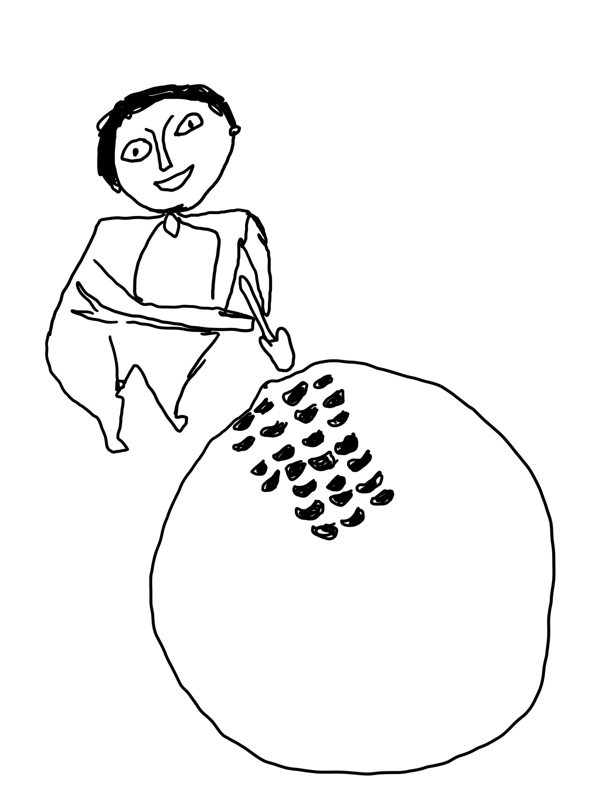
Davadelo
(Madagascar)
Dadavelo is a strong 13 years old boy. He lives in a very isolated and rural area. He is a student but often misses school because his parents want him to work the land in their cassava field. He really wants to go to school and be with his friends, but his parents are mad at him if he doesn’t work the land of their cassava field.

Slide 20
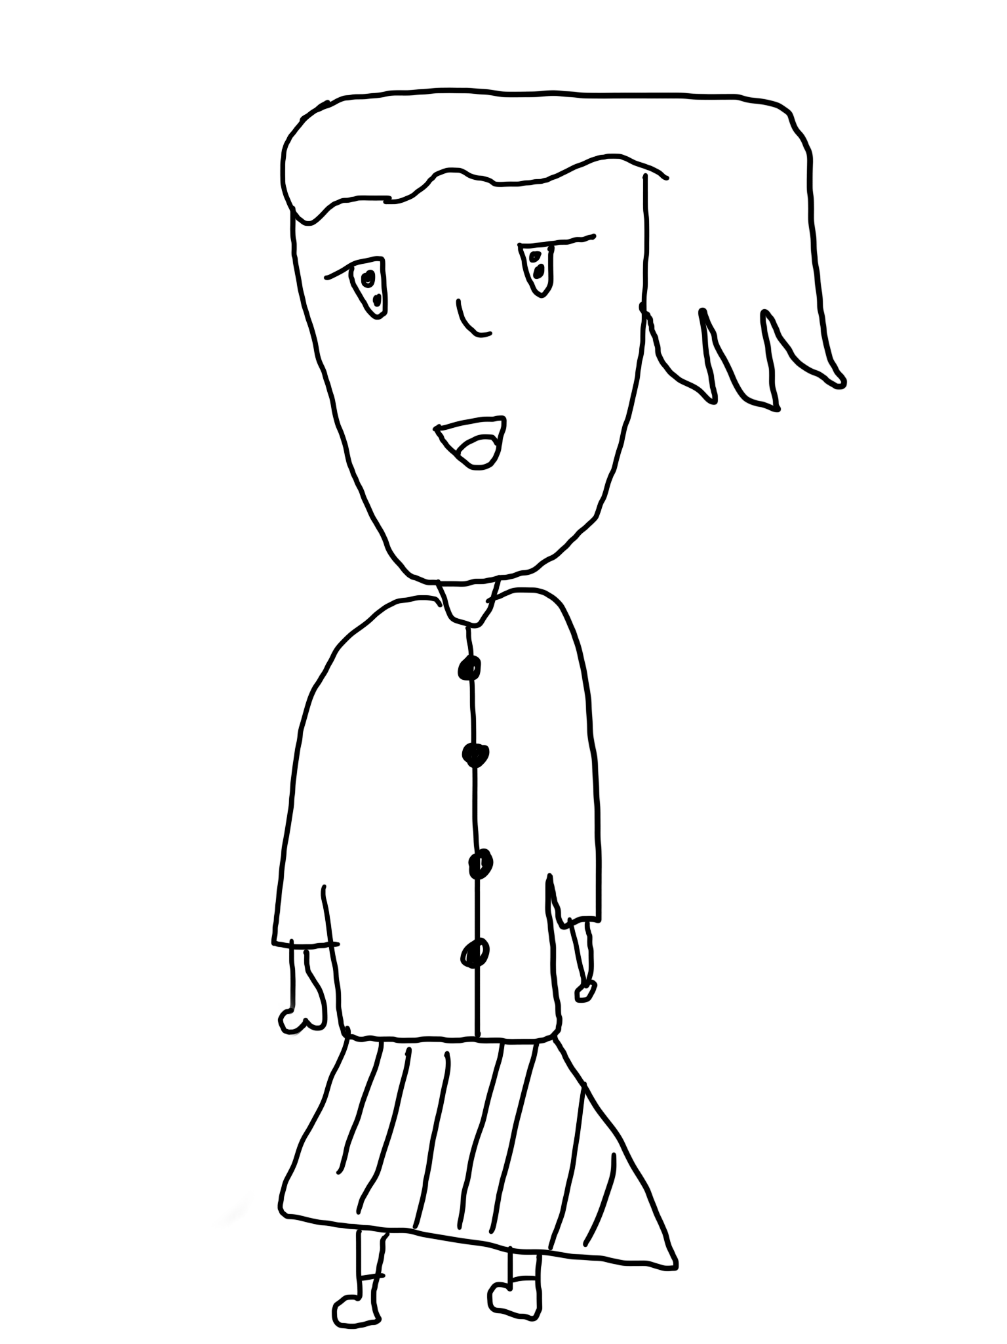
Sali
(Thailand)
She lived with her mother. Her mother worked at a sewing factory. They have no relatives. She had a birth certificate but without nationality. Sali was easy-going and generous. One day, after school, when she came back home, she found her mother laying down on the floor. Sali was shocked and called an ambulance. Her mother was taken to the hospital. When the doctor walked out from the emergency room, she then asked about her mother’s symptoms. She then found out that her mother had end stage cancer. She never knew that her mother was sick and now she found out that her mother’s health condition was severe. This was because Sali was focusing on her studies and her good grades. Two days later, her mother passed away. Sali was very sad and did not know what to do next. She became isolated and depressed.
She had to live by herself and felt stressed and lonely. Then, a friend recommended Sali to work part time. She earned money to take care of herself for almost a year and rented a room. Unfortunately, there were so many expenses. Sali did not have enough money to live. She had a friend. Her friend then suggested to her “let’s sleep with clients and earn money rather than giving our bodies to men for free”. Sali thought about her friend’s option and then told her friend to find a client for her. Her friend got clients for Sali. When Sali went with clients in the hotel room, the client sexually abused her and forced her to take drugs. Sali got addicted and became unconscious. She ended her life. “Wrong decisions change your life”.

Slide 21
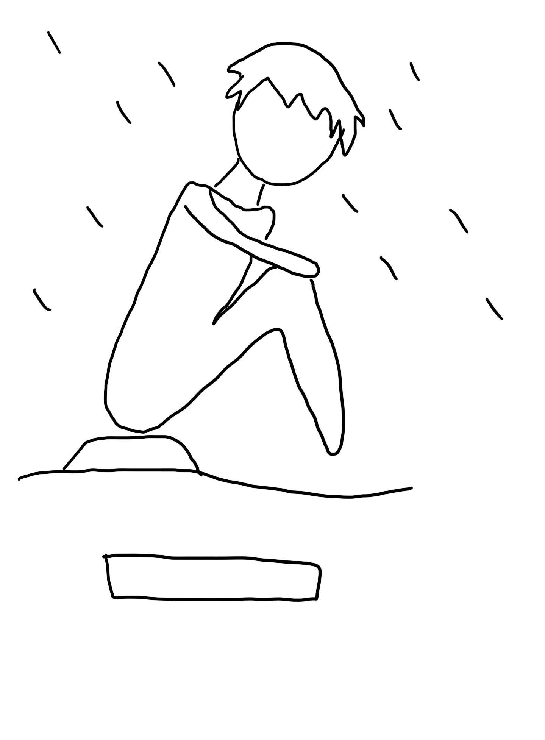
Jeff
(Philippines)
This is Jeff, he is a street kid. The reason for this is because he experienced a natural disaster and his parents also died. Now, he’s all alone.
When it comes to injustice, he was chosen because he was a street child, and Jeff didn't have parents or any relatives to turn to, so he only had himself to rely on. He had no one else to depend on, which made him one of the most vulnerable kids when it comes to child exploitation.
He also has no shelter and she became a victim of child labour to survive. He was forced to work even though it’s illegal. You’re only allowed at the age of 18, but he’s 10 years old. He was unable to go to school and study leading to a lack of awareness, especially to human rights, policies and laws that protect children’s rights. He really lacks knowledge. As a result, he had an experience with one group where they enticed children to come with them. They exploit them in exchange for money. They bring these children to hotels where there are plenty of kids. They were fed there. Their needs were provided without them knowing that the group had bad intentions. Since this group wants to earn a big sum of cash through child exploitation. The kids are asked to undress and have nude photos and videos. That was basically their experience, and it’s very traumatising. He cried and refused to show his face. I intentionally did not show his face, cause it seems to him that he has only himself to rely on. He seemed to accept that he’s becoming numb.

Slide 22
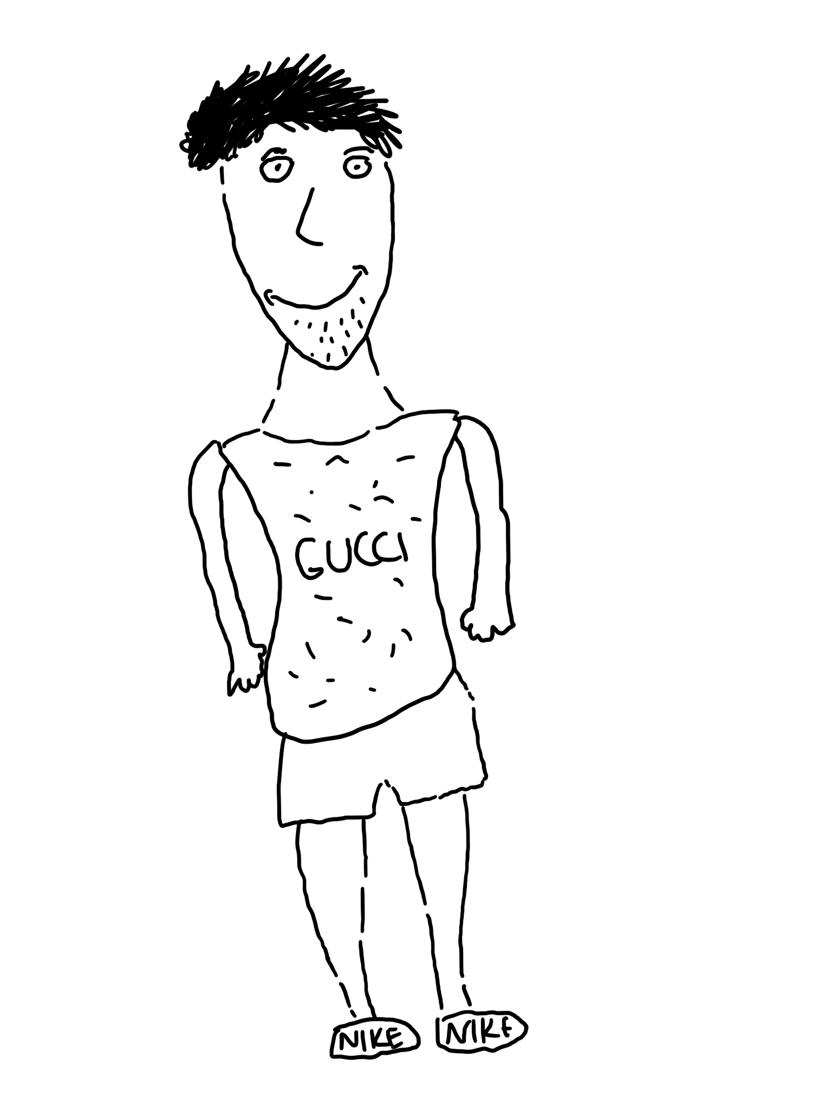
Boy
(Moldova)
This boy wears designer clothes because he is from a very rich family. He is 16 years old. He works in his uncle’s pizza shop. He lives with his parents. He can afford to buy designer clothes and whatever he wants. He does not have to pay for food because his parents are rich. This boy is walking from school right now and someone is watching him and wants to kidnap him for ransom.
This boy is vulnerable to exploitation because he comes from a rich family, he wears expensive clothes and has an expensive phone and various accessories, so the robbers probably think they could make a lot of money.
The colour of his skin matters, maybe the religion he adheres to or something else makes him vulnerable to danger. Some kids really show that they haven't tried bad things yet and it denotes that they are healthy and can be taken to sell for organs and other things is that we can see that they are quite fit, strong and healthy then they can be used for labour, or they are from rich families and can be kidnapped for ransom.

Slide 23
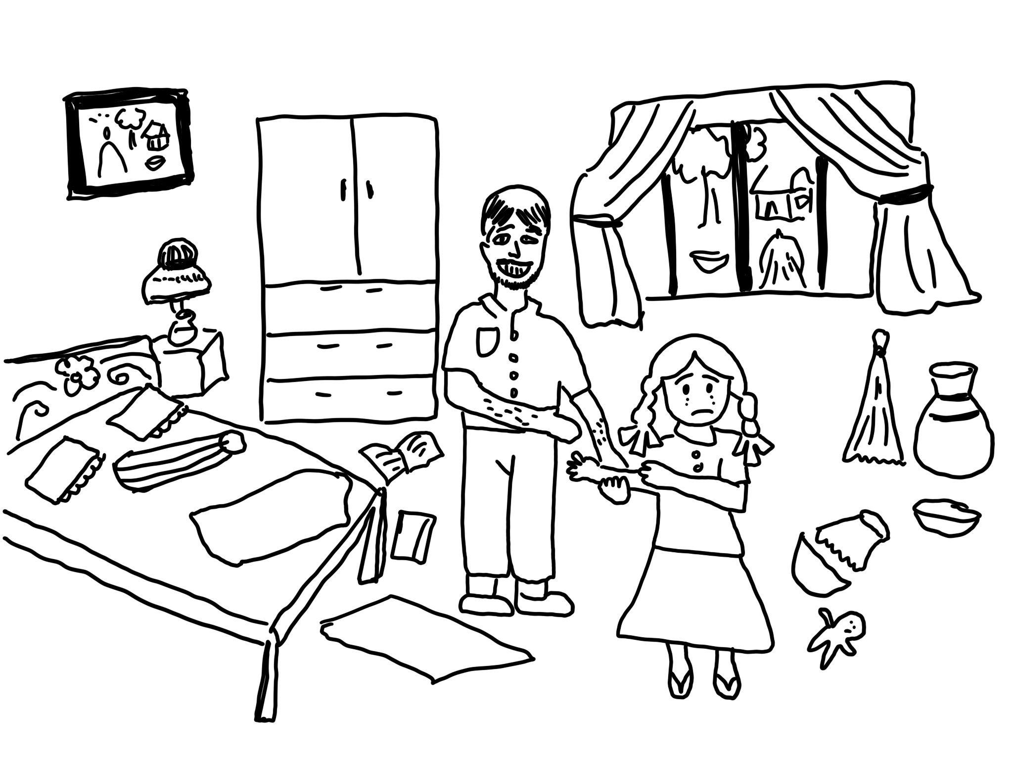
Joba
(Bangladesh)
This is Joba who is 17 years old. She passed class 10 last year, and this year she took admission in 11 class in a renowned college in Dhaka city. She belongs to a lower middle-class family, and her parents both work in a garment factory. Joba mostly stays alone at home when her parents go to and back from work. As she is the only daughter of her parents, she always goes to and back from the college alone by bus. One day after college she took a bus to get home. A middle-aged man, who looked like a hooligan sat on the opposite side and masturbated looking at her the entire time. She was terrified and scared. When the bus stopped at a stoppice, the man suddenly sat behind her, just next to Joba’s seat. After a few minutes, Joba started to feel the back of hair moving. At first, she thought it was caused by a breeze as the bus was moving, but then she clearly felt fingers playing with her hair and neck. She felt shocked and confused for a moment telling herself he’d probably done it by accident. However, just a moment later she also felt that the man was turning her scarf and trying to pressure against her breast. She turned around and she was faced with the man smiling at her. His ‘smile’ made her blood run cold.
Though Joba observed that the man was turning her scarf, the man was reluctant to stop such nasty work. In front of Joba he was repeatedly touching her scarf. Joba immediately pushed her attention through several people on the bus. But the apathy of others on the bus made her feel like she should be quiet about it too. She was so shocked, embarrassed and humiliated by the silence of the passengers. Then she started to cry and shouted to the men if I were your sister, whether you are able to do this nasty task. He looked ever so slightly uncomfortable, but mainly sad and disappointed. The man stepped out of the bus one stop before Joba did, but he took time to look at her. Joba never reported it nor told anyone else about it. Because she thought that they made her feel like it was her fault and that she should be ashamed. But she knows that it was not her fault, and she no longer feels ashamed.

Slide 24
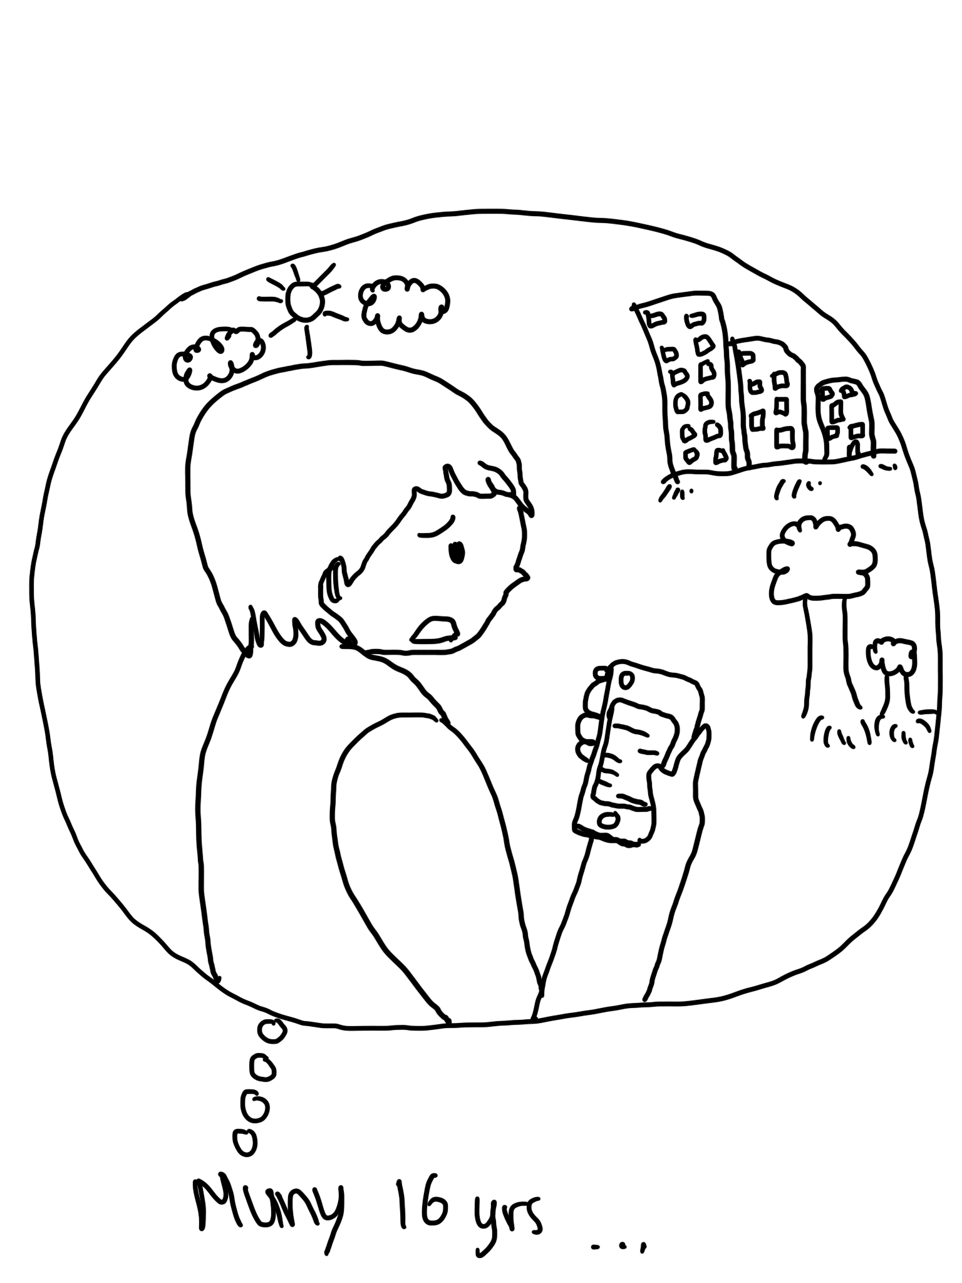
Muny
(Cambodia)
Muny is a 16 years old girl , she was born in a poor family and her parents always argue with others in the family. As a result, she feels lonely and she always uses social media to express how she feels to release her stress and keep sharing her feelings on social media. One day, a stranger approaches her online and chats to her every day to let her share her sorrow and build trust until Muny feels more close to that person than her family. Later on that stranger sent her intimate picture to Muny as she was very strange and shocked too but later on that stranger requested her to send her nude photo as that stranger kept insisting so Muny agreed to send her one nude photo to that stranger. She doesn’t want the stranger who is close to her online getting upset. After she sent her photo , the stranger kept asking for more pictures and threatened that if Muny​ stopped sending her the pictures, they would post her picture on social media and share it with her friend.

Slide 25
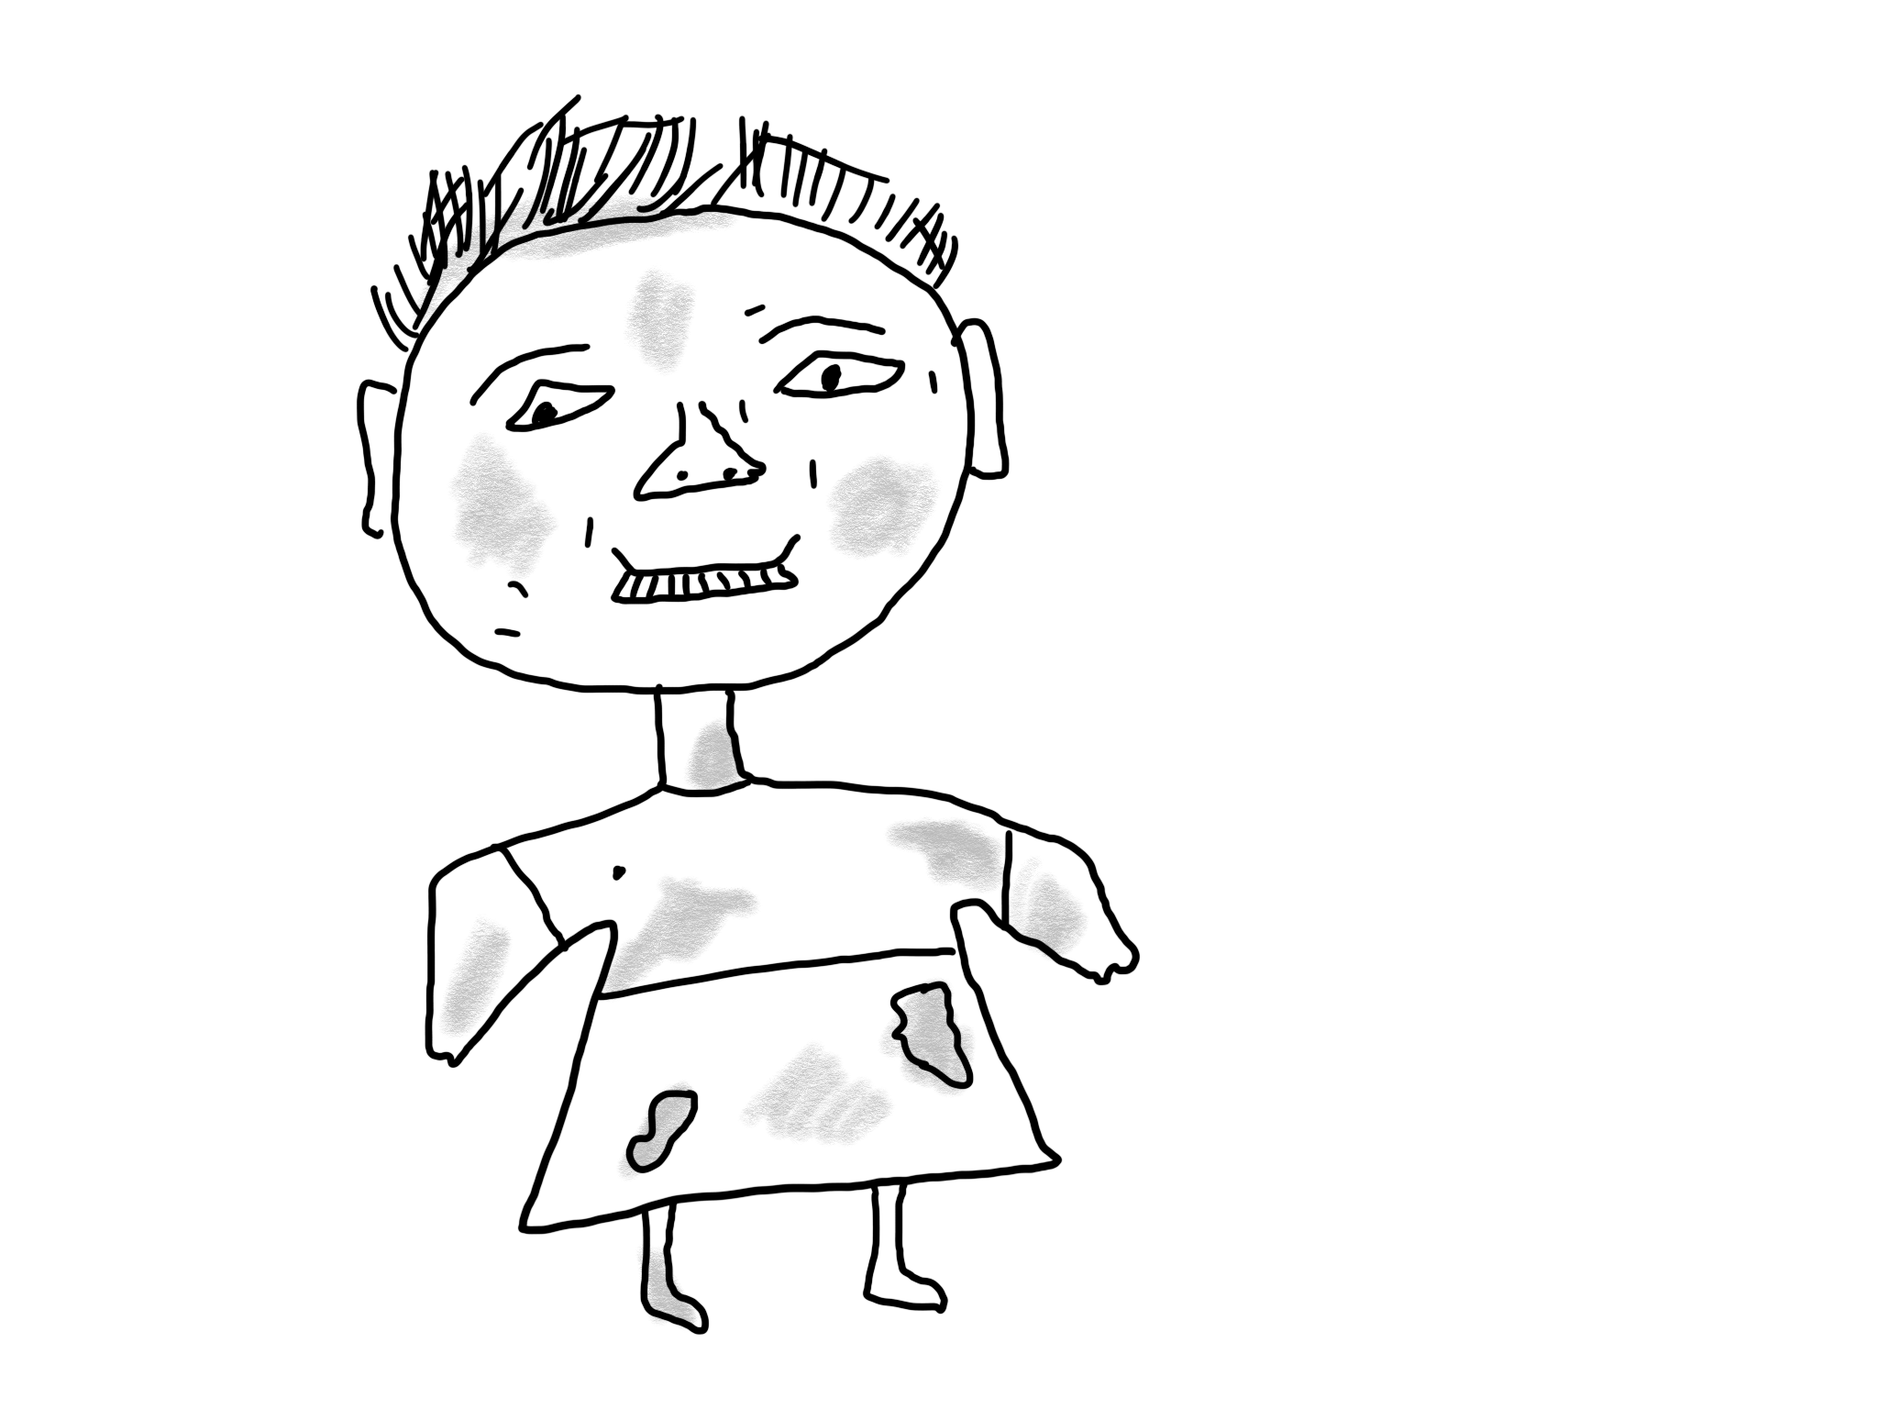
Stella
(Kenya)
The first avatar profiled Stella, a 16 years old girl, an orphan who lost both her parents in her early years. Currently Stella, who is homeless, stays at a dump site in Kabati estate in Naivasha Sub County of Nakuru County. As expected, Stella’s family and friends at her dwelling are street children, drug peddlers and petty criminals. Because of her lifestyle (lack of proper nutrition, habitation, schooling and other critical child rights components), Stella is emaciated and looks hungered. Stella is exposed to sexual exploitation which in turn puts her at risk of STIs, early pregnancy, drug addiction, being arrested by police and many other such abuses. Stella needs urgent rescuing and rehabilitation for the sake of her development and the support can only come from well-wishers.

